Slide 1
Weekly Reflective Portfolio - International Course
Course 2 - Introduction to Needs Assessments
Your Week 2 Portfolio
Name:
Please add your name here

Slide 2
Introduction - This document is your weekly reflective portfolio.
Each week you will have a portfolio to download.
You should work through the weekly activities set out in the portfolio and also use it to reflect on the weekly course content.
In your reflections you should think critically about how the weekly content impacts on your day to day life and work.
Your assignment tasks are also explained in this portfolio. Each assignment task will be clearly labelled and will be marked by a course facilitator. You should submit your assignment within this portfolio. You will receive feedback on your assignments.
You will need to upload your reflective portfolio at the end of every week (by Sunday). You can submit your portfolio as a link or as a pdf or powerpoint. You will not receive feedback each week. However, the portfolio is an essential part of the course and is a requirement for certification.
If you have any questions, please do get in touch with your facilitators.

Slide 3
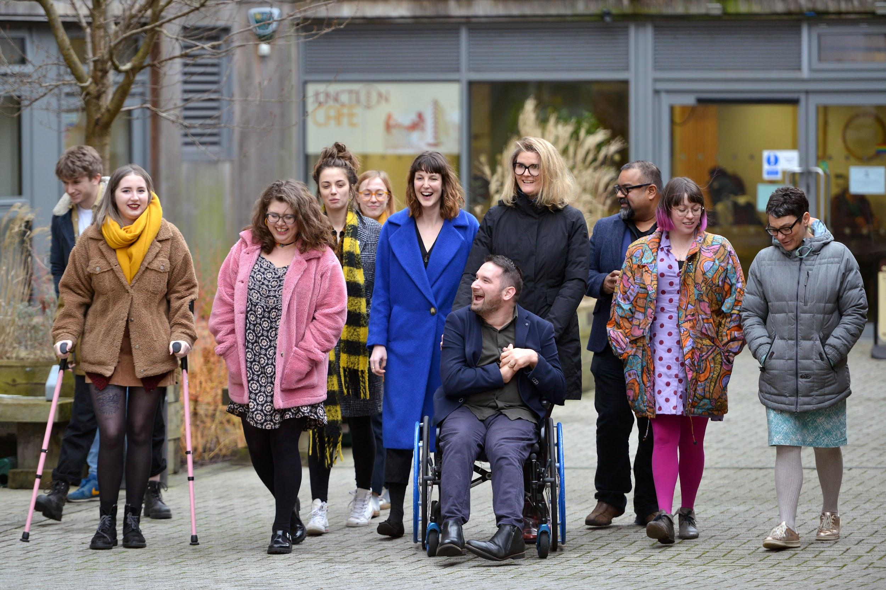
Week 2: Intro to rapport building, dynamics and communicating in needs assessments
Welcome to week 2! This week we will explore some of the key skills required for competent needs assessing: Rapport Building, communication and understanding your position as an assessor.
You will need to complete the following in this portfolio this week:
All week 2 activities
Your Reflective Account on this week's content
You should then upload your portfolio to the moodle platform (as a link, PDF or powerpoint document) by the end of the week.

Slide 4
Week 2 - Activities
As you work through the content we would recommend that you collaborate with others on these activities.
These activities are not assessed and are a way for you to expand your knowledge.
You can provide evidence of these activities on the following slides.
This weeks activities are:
The importance of communication exercise
Maintaining Boundaries in a Needs Assessment
Building Rapport
The activities are designed to get you thinking about the content and to encourage questions. Each activity is described in the following slides.
Please do post your questions on the forum - the facilitators and your peers will respond to these questions throughout the course.

Slide 5
Activity 1:
The importance of communication exercise
1 of the key skills that a needs assessor requires is to be able to communicate effectively. In this exercise we’ll explore the impact of different communication techniques.
For this exercise you will need to work with a peer. Decide who will be “the listener” and who will be “the talker”.
The talker should describe a difficult scenario e.g. they’ve had a bad day at work.
The Listener will listen to them talking and will choose to act out one of the following scenarios, using their body language and communication skills:
That they are too busy
That they already know the story being shared
That they really care and want to listen
When finished, the talker should guess which of the scenarios was being acted out. Give feedback to each other on how it felt to take part in the conversation.
How did you find the exercise? Share your reflection in this box.

Slide 6
Activity 2:
Maintaining Boundaries in a Needs Assessment
In a needs assessment, maintaining appropriate boundaries between yourself and the participant is very important. In pairs or groups, discuss what your strategies may be for setting boundaries. You can also research strategies to include or try.
Write or mindmap your ideas below:

Slide 7
Activity 3:
Building Rapport
This week we explored how to build rapport and help a needs assessee to feel comfortable in an assessment. Research 3 different strategies for how you could build rapport and share these below.
Strategy 1
Strategy 2
Strategy 3

Slide 8
Reflective Account Week 2
Please use this space to reflect on what you have learnt this week.
Some prompts:
How will this new content impact your work?
What did you learn?
Is there anything you’d like to know more about?
Please write your reflection here. You should write between 100-150 words.
You can resize this textbox if necessary.
We are happy for you to upload an audio or video of your reflection if you would prefer.
You can also upload images.
(You can delete this text)

Slide 9
Your questions, thoughts, comments...
Thank you for completing this week's key activities, content and reflection. You can use this space to share any comments, thoughts or questions that you may have that you’d like the facilitators to be aware of.
Add your questions here...

