Slide 1
Weekly Reflective Portfolio - International Course
Course 1 - Introduction to Assistive Technology
Your Week 3 Portfolio
Name:
Please add your name here

Slide 2
Introduction - This document is your weekly reflective portfolio.
Each week you will have a portfolio to download.
You should work through the weekly activities set out in the portfolio and also use it to reflect on the weekly course content.
In your reflections you should think critically about how the weekly content impacts on your day to day life and work.
Your assignment tasks are also explained in this portfolio. Each assignment task will be clearly labelled and will be marked by a course facilitator. You should submit your assignment within this portfolio. You will receive feedback on your assignments.
You will need to upload your reflective portfolio at the end of every week (by Sunday). You can submit your portfolio as a link or as a pdf or powerpoint. You will not receive feedback each week. However, the portfolio is an essential part of the course and is a requirement for certification.
If you have any questions, please do get in touch with your facilitators.

Slide 3
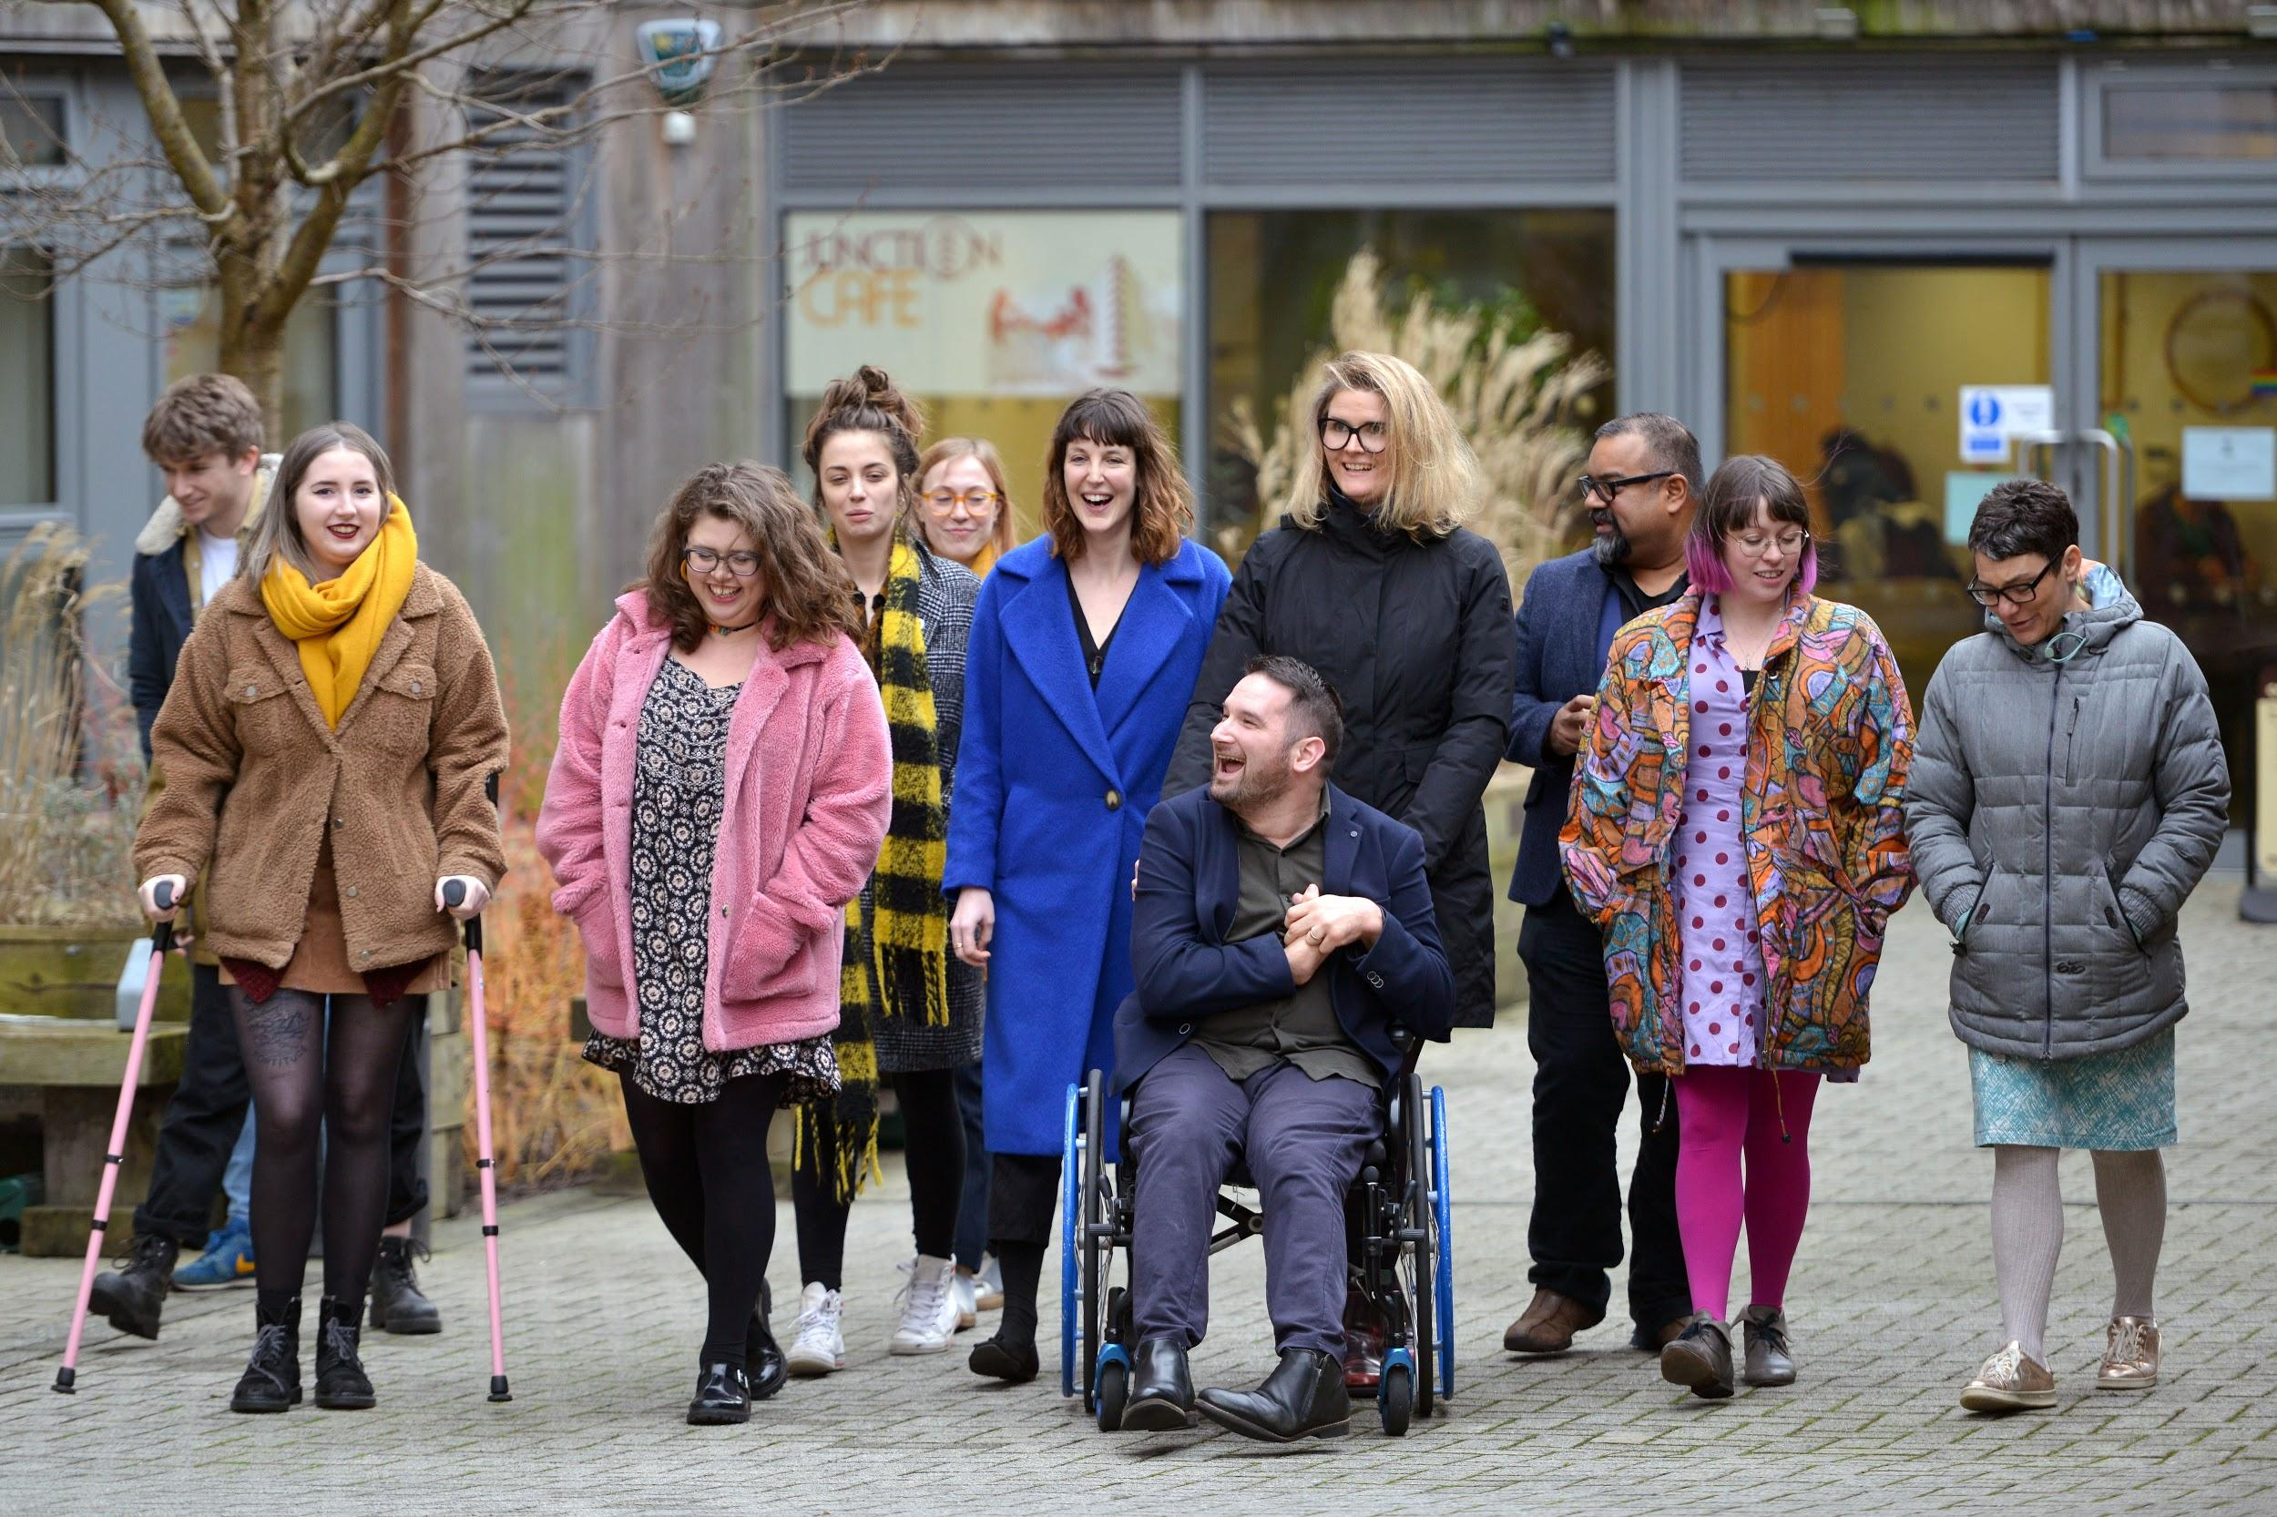
Week 3: Assistive Technology for Barriers to Reading
Welcome to week 3! This week we are exploring software that will support individuals who face barriers to reading.
You will need to complete the following in this portfolio this week:
2 or more of the optional activities
Your Reflective Account on this week's content
There is no assignment due this week.
You should upload your portfolio to the moodle platform (as a link, PDF or powerpoint document)

Slide 4
Week 3 - Activities
As you work through the content we would recommend that you collaborate with others on these activities.
These activities are not assessed and are a way for you to expand your knowledge.
You can provide evidence of these activities on the following slides.
This week you should choose 2 or more activities:
Robobraille
Microsoft Lens
Natural Reader
Chrome Reader View
Talk Free
iOS Spoken Content
NVDA
The activities are designed to get you thinking about the content and to encourage questions. Each activity is described in the following slides.
Please do post your questions on the forum - the facilitators and your peers will respond to these questions throughout the course.

Slide 5
Activity 1:
Robobraille
Go to the Robobraille website and convert the paragraph of text in the box below into braille or an audio file.
Upload the file or a screenshot of the file to this slide.
Please note, you’ll need access to an email address for this activity.
“Assistive technology is a gamechanger for many individuals. Not only does it remove access barriers but it also enables individuals to thrive in education and at work.”

Slide 6
Activity 2:
Microsoft Lens
Download Microsoft Lens (android) (iOS).
Use the MS Lens tool to take a picture of a book, letter or page with text.
Open this with the immersive reader option. Adjust the settings to change the:
Background colour (theme)
The font
The text size.
Upload a screenshot of your screen.

Slide 7
Activity 3:
Natural Reader
Download any document from the course supporting documents - The SDG Booklet is a good place to start. Open this in Natural Reader Online.
Practice doing the following things:
Play and Pause the reading of the document
Change the voice
Adjust the Speed of the voice
Turn on ‘dark mode’
Add some screenshots of your progress to this slide.

Slide 8
Activity 4:
Chrome Reader View
ome
Install the Chrome Reader View Extension (please note you need to be using the Google Chrome Browser).
Visit the Diversity and Ability Website and take a screenshot of the page in standard view. Then turn on Chrome Reader View and take a 2nd screenshot of the new page view.
Before
After

Slide 9
Activity 5:
Talk Free
Download Talk FREE onto your android device. Import some text into the app - screenshot and add the picture to this slide.
Now try to import a web page directly from your internet browser - you could try using the Diversity and Ability website upload a screenshot of your progress.
Text Upload
Web Page Import

Slide 10
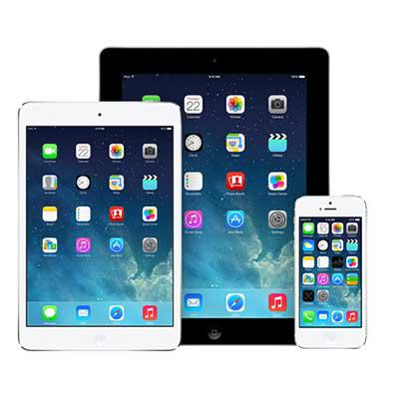
Activity 6:
iOS Spoken Content
Watch the iOS Spoken Content video to learn how to enable spoken content.
Visit the Diversity and Ability website and turn on spoken content and listen to what is read aloud.
Provide a screenshot and answer the questions below:
Was it easy to understand the text?
Do you think it was faster or slower than reading it yourself?
Do you think text-to-speech will benefit the individuals that you support?

Slide 11
Activity 7:
NVDA
Explore the NVDA Website and watch the core content videos to answer the following questions:
What is NVDA?
Who can NVDA support?
Is NVDA free?
Would you usually use a mouse with NVDA?
Do you think NVDA would support anyone that you work with?

Slide 12
Reflective Account Week 3
Please use this space to reflect on what you have learnt this week.
Some prompts:
How will this new content impact your work?
What did you learn?
Is there anything you’d like to know more about?
Please write your reflection here. You should write between 100-150 words.
You can resize this textbox if necessary.
We are happy for you to upload an audio or video of your reflection if you would prefer.
You can also upload images.

Slide 13
Your questions, thoughts, comments...
Thank you for completing this week's key activities, content and reflection. You can use this space to share any comments, thoughts or questions that you may have that you’d like the facilitators to be aware of.
Add your questions here...

