Slide 1
Train The Trainer: Week Six

Slide 2
This Session will be recorded
If you prefer you can:
Turn off your camera
Change your Zoom name
Ask questions via the chat
Notes:
Inform the participants that the session is due to be recorded and if they feel more comfortable, they can turn off their camera or change their name.
Participants may also leave but we encourage them to message privately before doing so.

Slide 3
Helpful Housekeeping
Please keep
your microphone muted
Please do put questions in the chat box or verbalise them at the end
This is a safe and inclusive learning space
Notes:
We are just going to touch on some helpful housekeeping to make sure we all get the most out of the session. Please do keep your microphone muted when not speaking, as background noise can be very distracting. If you have any questions, please do feel free to take yourself off of mute at any time and voice them, or you can use the chat box throughout. There will be time at the end for any questions, reflections or thoughts as well.
This is a safe and inclusive learning space, so if you have any questions that you might have felt uncomfortable voicing until now, or anything that you would like to clarify, this is a space that welcomes that.

Slide 4
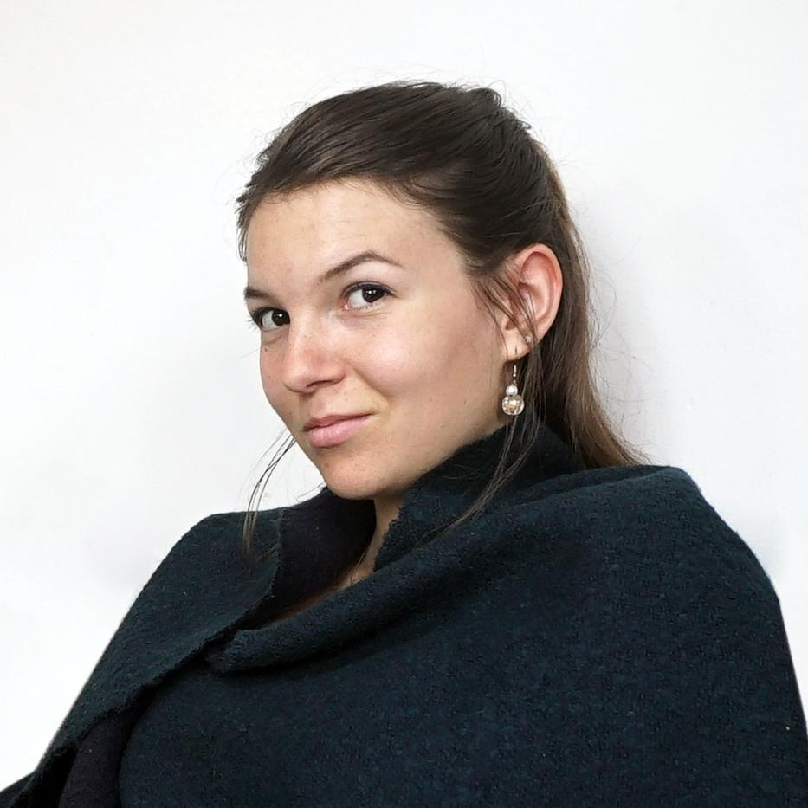
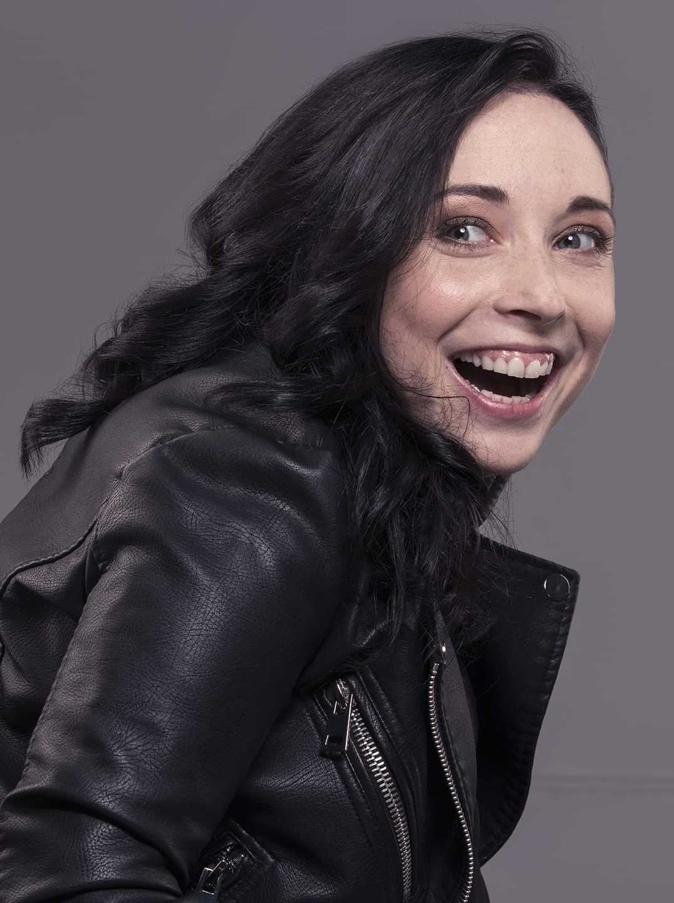
Who we are
Diversity and Ability is a multi award-winning social enterprise led by and for disabled people which supports organisations to create inclusive cultures where diversity is valued and people can thrive.
D&A specialises in training & consultancy, supporting both employees and employers to be the best they can be. D&A is driven by authentic lived experiences.
Alice Dodds
Operational Manager
85% of our team identify as disabled or neurodiverse
100% of our clients would reuse our services
Roxanne Steel
Accessibility and Inclusion Specialist
Notes:
We are Diversity and Ability, a disabled-led social enterprise which supports organisations to create inclusive cultures where diversity is valued and people can really thrive and reach their full potential.
We specialise in training and consultancy, supporting both employees and employers to be the best they can be.
85% of our team identify as disabled or neurodiverse. [Facilitator(s) introduces themself/themselves personally]
We are really excited to be here with you today!

Slide 5
Session Overview
Introductions and Helpful Housekeeping
Break Weeks Reflections
Mock Delivery and Action Plan Presentations
Course Reflections
Whats Next
Atif - Thanks and Reflections
Questions

Slide 6
Week Three & Break Week Reflections
Notes:
Discussion

Slide 7
Week Three Reflections
Please share one reflection from the last weeks -
either unmute or message in the chat
Notes:
Space to reflect on the live session
What they learnt from post session assignments
Any Questions - we will answer as many and we can in session - but will upload responses on moodle for people to access

Slide 8
Mock Delivery and Action Plan Presentations
Notes:
Discussion

Slide 9
Action Planning and Mock Delivery
During the break week
We asked you to
Action plan you first Action Plan your first assistive Technology Course
Record and Mock Deliver a session introducing the Assistive Technology to a fellow learner
The next few slide we’ll reflect on the experience

Slide 10
Action Plans
How did you find the action plan process?
What Challenges did you face?
Any Questions?
Notes:
Our hopes for the future, following the completion of the course

Slide 11
Mock Delivery
Pairs to give feedback on experience
As a facilitator
As a participants
D&A to give feedback on recordings
(General/Overall)
Personal feedback will be given via moodle

Slide 12
Course Reflections
Notes:
Discussion

Slide 13
Course Reflection
Week One: We explored our mutual values and aspirations for the course - discussed why this course is so important and looked over the materials
Week Two:Together we explored essential skills needed in regards to teaching and facilitation when running an online course
Week Three:This week we discussed all things administration and logistics including marking
Week Four: No live session - This week you went through activities in your portfolio including Marking a Mock Needs Assignment
Week 5:No Live Session - you went through activities in your portfolio including recording a mock delivery session
Week Six : We are here!!
Notes:
We’ll breakdown the course week by week including assignments

Slide 14
Course Reflection - Stand out participants
Add Name
Add Name
Add Name

Slide 15
Interesting things you’ve learnt
Personal reflections - what you learnt about yourself (teaching and facilitation skills)
Any Concerns we can support you with
Discussion

Slide 16
Whats Next?
Notes:
Discussion

Slide 17
Next Steps
Will support delivery of your first course
Will offer annual refresher courses
Please do stay in touch

Slide 18
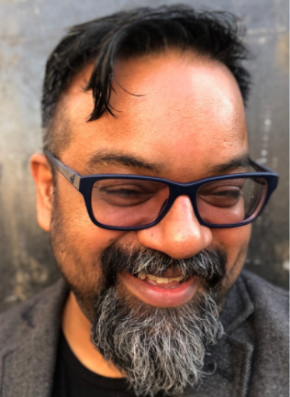
Atif - Thanks and Reflections
Notes:
Discussion

Slide 19
Week 6 - Post Session Assignments
Notes:
Discussion

Slide 20
Post Session Expectations
Within the weeks portfolio we ask you to reflect on the following and complete any activities before uploading it to your moodle
What are your aspirations for future learners following this course?
Where do you think Assistive Technology Training will be in 10 years time?
Mop up week for any pending work

Slide 21
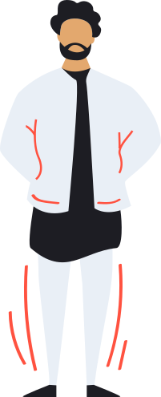
Any questions?

Slide 22
Thank you for your commitment and Good luck for the future

