Slide 1
Weekly Reflective Portfolio – International Course
Train the Trainer - Week Two
Your Week 2 Portfolio
Name:
Please add your name here

Slide 2
Introduction - This document is your weekly reflective portfolio.
Each week you will have a portfolio to download.
You should work through the weekly activities set out in the portfolio and also use it to reflect on the weekly course content.
In your reflections you should think critically about how the weekly content impacts on your day to day life and work.
Your assignment tasks are also explained in this portfolio. Each assignment task will be clearly labelled and will be marked by a course facilitator. You should submit your assignment within this portfolio. You will receive feedback on your assignments.
You will need to upload your reflective portfolio at the end of every week (by Sunday). You can submit your portfolio as a link or as a pdf or powerpoint. You will not receive feedback each week. However, the portfolio is an essential part of the course and is a requirement for certification.
If you have any questions, please do get in touch with your facilitators.

Slide 3
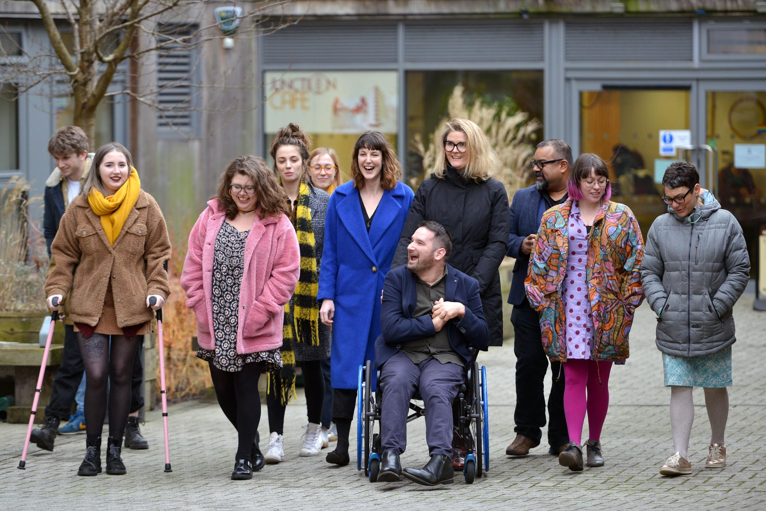
Week 2: Teaching and Facilitating Skills
Welcome to week 2! This week we are focussing on Teaching and Facilitating Skills ”. We’ll also explore how to support learners to contribute and how and when to act on feedback
You will need to complete the following in this portfolio this week:
All week 2 activities
Your Reflective Account on this week's content
There is no assignment due this week.
You should upload your portfolio to the moodle platform (as a link, PDF or powerpoint document)

Slide 4
Week 2 - Activities
As you work through the content we would recommend that you collaborate with others on these activities.
These activities are not assessed and are a way for you to expand your knowledge.
You can provide evidence of these activities on the following slides.
This weeks activities are:
Exploring Facilitation Challenges
Reflecting on your teaching and facilitation skills
Acting on Feedback
The activities are designed to get you thinking about the content and to encourage questions. Each activity is described in the following slides.
Please do post your questions on the forum - the facilitators and your peers will respond to these questions throughout the course.

Slide 5
Week One: Reflection Assignment (Not Marked)
Facilitation Challenges
Use following slides or additional sheet provided as a space to reflect on the following questions - (in whatever format you would like e.g. text, image, creating a slide, audio file, video etc.)
Question One: What challenges could you face whilst facilitating a session (think of at least 3)
How would you deal with this?
How could you reduce the chances of this happening?
Question Two: What skills do you feel you already have for teaching/facilitating that could support with these challenge?
(think of at least 3)
Question Three :What areas do you feel you need support?

Slide 6
Week One: Reflection Assignment (Not Marked)
Facilitation Challenges

Slide 7
Week Two: Reflection Assignment (Not Marked)
Reflecting on your teaching and facilitation skills
What skills do you feel you already have for teaching/facilitating
What areas do you feel you need support?
You can use this space to reflect on your skills

Slide 8
Week Two : Reflection Assignment (Not Marked)
Acting on Feedback
Use the below as a space to reflect on a time that you’ve been given some feedback and how you acted on it - (in whatever format you would like e.g. text, image, creating a slide, audio file, video etc.)

Slide 9
Reflective Account Week 2
Please use this space to reflect on what you have learnt this week.
Some prompts:
How will this new content impact your work?
What did you learn?
Is there anything you’d like to know more about?
Please write your reflection here. You should write between 100-150 words.
You can resize this textbox if necessary.
We are happy for you to upload an audio or video of your reflection if you would prefer.
You can also upload images.

Slide 10
Your questions, thoughts, comments...
Thank you for completing this week's key activities, content and reflection. You can use this space to share any comments, thoughts or questions that you may have that you’d like the facilitators to be aware of.
Add your questions here...

