Slide 1
Zoom Guide - Train the Trainer

Slide 2
What is Zoom?
Zoom is a cloud-based video conferencing tool that lets you host virtual one-on-one or team meetings easily. With audio, video, accessibility and collaboration features, this remote communication tool connects remote team members with each other.

Slide 3
Key Features you should know
Basic / free - 2 people in one meeting, as long as you need, no restrictions
More than 2 people - 40 minute limit
For sessions longer than 40 mins - you will need to upgrade to a paid subscription
Benefits - can share video, audio and screens, record and annotate as well as create break out rooms
Accessibility features such as live transcription, dark mode, focus mode

Slide 4
Creating a Scheduled Meeting
Notes:
Discussion

Slide 5
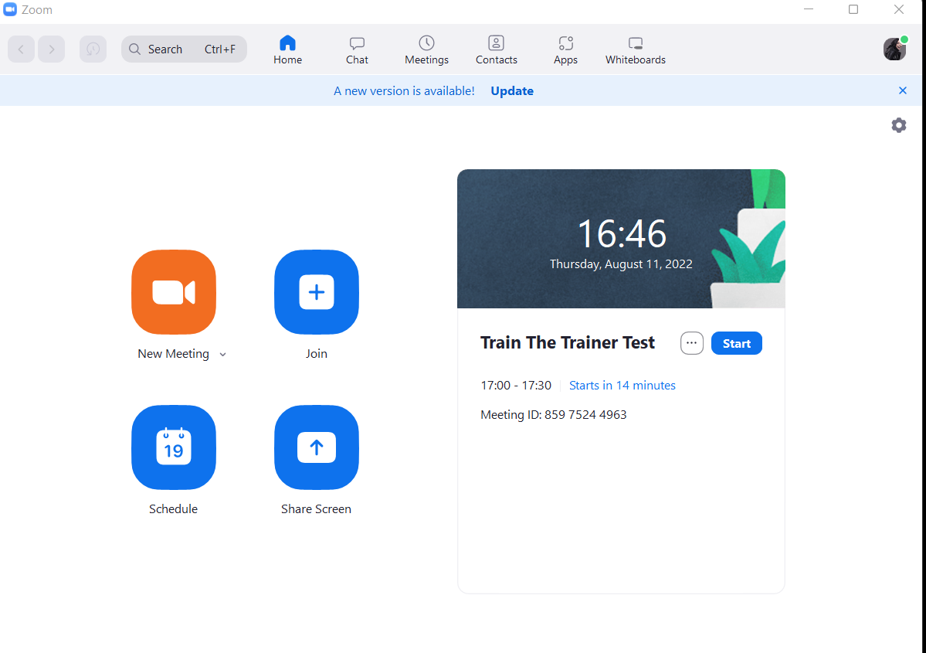
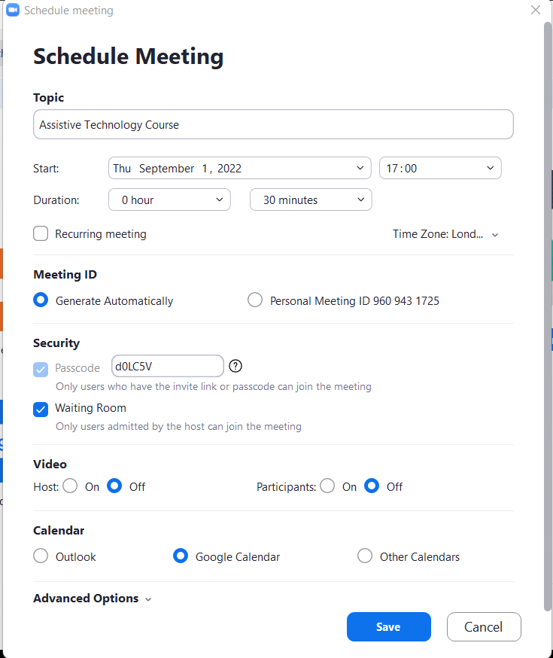
Creating a Scheduled Meeting
If you haven’t done so already you’ll need create a scheduled meeting
It will bring up this pop up which you can edit it

Slide 6
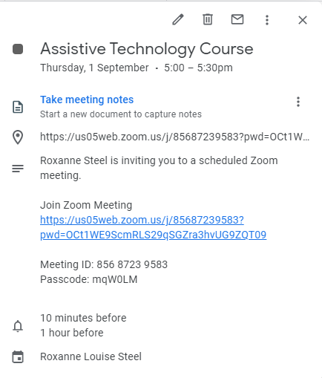
Creating a Scheduled Meeting
Once you’ve saved this it should now be in your calendar
Which will include the details for entering the zoom which can be copied and pasted in an email to send to attendees

Slide 7
Getting to know the controls
Notes:
Discussion

Slide 8
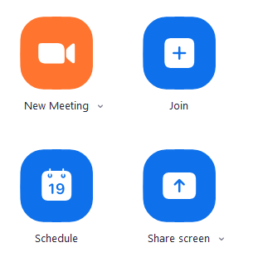
Getting to know the Controls
Open Zoom: Either start New Meeting or schedule one
Gives you control over the meeting. Important now as screen sharing permissions changed
Allows you to share your screen or to encourage participants to
All video options including stop/start and selecting virtual background
Allows you to record your session
On screen emoji-like reactions
Allows you to see participants and remove and give permission to record (see next slide)
All microphone options including (un)mute and selecting source
Chat is very useful if the audio isn’t working properly

