Slide 1
Weekly Reflective Portfolio - International Course
Course 2 - Introduction to Needs Assessments
Your Week 4 Portfolio
Name:
Please add your name here

Slide 2
Introduction - This document is your weekly reflective portfolio.
Each week you will have a portfolio to download.
You should work through the weekly activities set out in the portfolio and also use it to reflect on the weekly course content.
In your reflections you should think critically about how the weekly content impacts on your day to day life and work.
Your assignment tasks are also explained in this portfolio. Each assignment task will be clearly labelled and will be marked by a course facilitator. You should submit your assignment within this portfolio. You will receive feedback on your assignments.
You will need to upload your reflective portfolio at the end of every week (by Sunday). You can submit your portfolio as a link or as a pdf or powerpoint. You will not receive feedback each week. However, the portfolio is an essential part of the course and is a requirement for certification.
If you have any questions, please do get in touch with your facilitators.

Slide 3
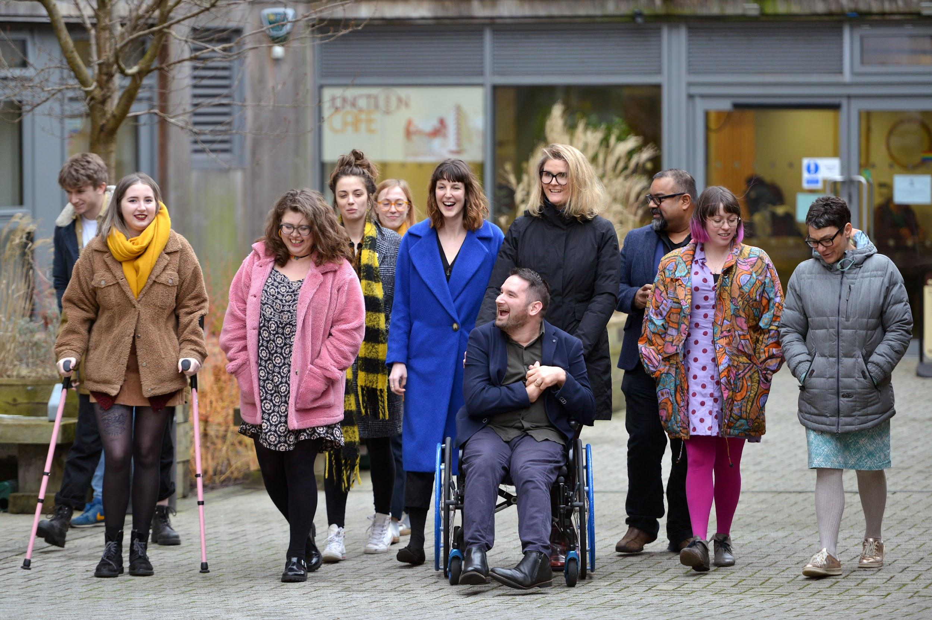
Week 4: Making recommendations in the Needs Assessment & Incorporating Assistive Technology into Needs Assessments
Welcome to week 4! This week we will start to think about how a needs assessor can approach assistive technology and the needs assessment report writing process.
You will need to complete the following in this portfolio this week:
All week 4 activities
Your Reflective Account on this week's content
You should then upload your portfolio to the moodle platform (as a link, PDF or powerpoint document) by the end of the week.

Slide 4
Week 4 - Activities
As you work through the content we would recommend that you collaborate with others on these activities.
These activities are not assessed and are a way for you to expand your knowledge.
You can provide evidence of these activities on the following slides.
This weeks activities are:
Explaining what a software is
Justifying Assistive Technology
The activities are designed to get you thinking about the content and to encourage questions. Each activity is described in the following slides.
Please do post your questions on the forum - the facilitators and your peers will respond to these questions throughout the course.

Slide 5
Activity 1:
Explaining What a Software Is.
The 1st barrier I experience is…
The technology that could support me is…
The justification for this is...
A key part of every needs assessment will involve explaining key software to the assessee. Most often, the assessee won’t have any experience of assistive technology or the strategy that you are recommending that they apply. In this activity we would like you to practice explaining these key pieces of technology to a peer.
You can audio record this conversation or write notes below.
Tool 1: XMind
Tool 2: Natural Reader

Slide 6
Activity 2:
Justifying Assistive Technology
Once you have explained to your assessee the key elements of what a software does, you will need to justify the software and strategy in the needs assessment report.
We would like you to practice writing these justifications. You will need to identify a barrier that the software helps to remove and justify why this software would be beneficial to your fictitious needs assessee. Write or record your justification below.
XMind Justification:
Natural Reader Justification:

Slide 7
Reflective Account Week 4
Please use this space to reflect on what you have learnt this week.
Some prompts:
How will this new content impact your work?
What did you learn?
Is there anything you’d like to know more about?
Please write your reflection here. You should write between 100-150 words.
You can resize this textbox if necessary.
We are happy for you to upload an audio or video of your reflection if you would prefer.
You can also upload images.
(You can delete this text)

Slide 8
Your questions, thoughts, comments...
Thank you for completing this week's key activities, content and reflection. You can use this space to share any comments, thoughts or questions that you may have that you’d like the facilitators to be aware of.
Add your questions here...

