Slide 1
Weekly Reflective Portfolio - International Course
Course 2 - Introduction to Needs Assessments
Your Week 1 Portfolio
Name:
Please add your name here

Slide 2
Introduction - This document is your weekly reflective portfolio.
Each week you will have a portfolio to download.
You should work through the weekly activities set out in the portfolio and also use it to reflect on the weekly course content.
In your reflections you should think critically about how the weekly content impacts on your day to day life and work.
Your assignment tasks are also explained in this portfolio. Each assignment task will be clearly labelled and will be marked by a course facilitator. You should submit your assignment within this portfolio. You will receive feedback on your assignments.
You will need to upload your reflective portfolio at the end of every week (by Sunday). You can submit your portfolio as a link or as a pdf or powerpoint. You will not receive feedback each week. However, the portfolio is an essential part of the course and is a requirement for certification.
If you have any questions, please do get in touch with your facilitators.

Slide 3
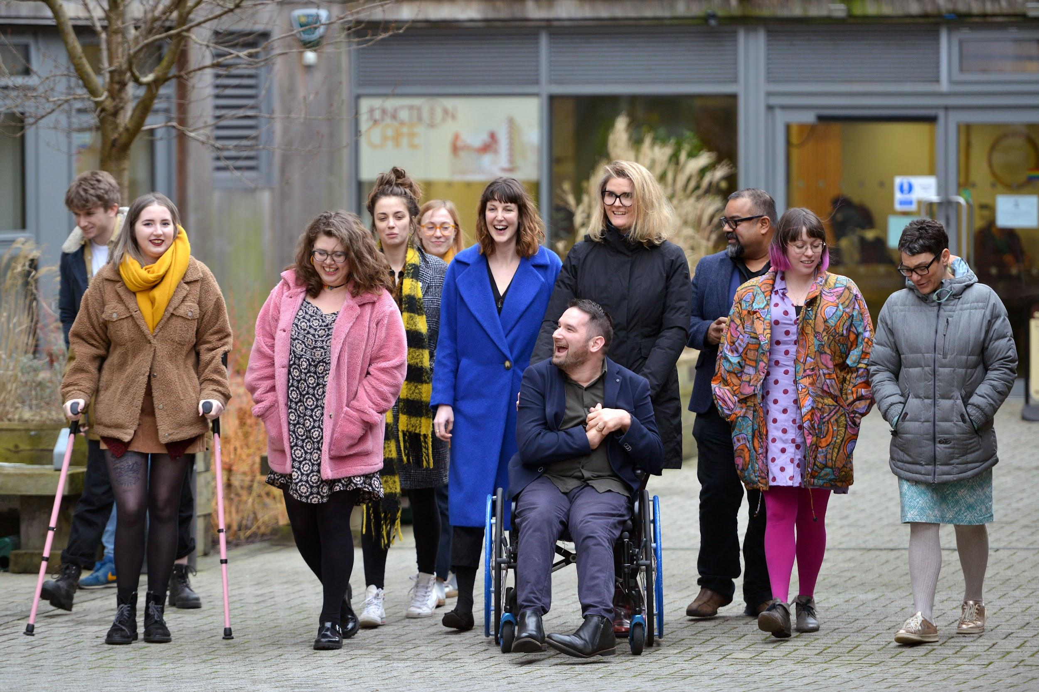
Week 1: Overview of the course and Introduction to Needs Assessments
Welcome to week 1! This week we will introduce you to the concept of a needs assessment, why it is important and the impact getting it right has. We will also learn what skills are needed to become a competent needs assessor.
You will need to complete the following in this portfolio this week:
All week 1 activities
Your Reflective Account on this week's content
You should then upload your portfolio to the moodle platform (as a link, PDF or powerpoint document) by the end of the week.

Slide 4
Week 1 - Activities
As you work through the content we would recommend that you collaborate with others on these activities.
These activities are not assessed and are a way for you to expand your knowledge.
You can provide evidence of these activities on the following slides.
This weeks activities are:
What is a needs assessment and why is it important?
Skills for Needs Assessments - Your Action Plan
Reflecting on the mock assessment video
The activities are designed to get you thinking about the content and to encourage questions. Each activity is described in the following slides.
Please do post your questions on the forum - the facilitators and your peers will respond to these questions throughout the course.

Slide 5
Activity 1:
What is a needs assessment and why is it important?
This week’s videos discussed what a needs assessment is, the key parts of a needs assessment and the
importance of taking a barrier-led, social model informed approach to assessing.
Using the space below to create a mindmap or write a description that answers the question: What is a needs assessment and why is it important?

Slide 6
Activity 2:
Skills for Needs Assessments - Your Action Plan
This week’s content discussed some of the skills that needs assessors should develop. Pick 3 different skills that you think are important for you to develop as a needs assessor, and create an action plan for how you will develop these skills.
The skill I want to develop is... | Why is this skill important? | My action plan to develop this skill is...

Slide 7
Activity 3:
Reflecting on the mock assessment video
In the final video this week, Adam and Meghan filmed a demonstration of a needs assessment. After watching this video, answer the questions below:
What did you learn from watching this assessment?
Was this approach to needs assessing what you were expecting? Please expand on your answer.
Describe the different stages of the needs assessment that you saw demonstrated.

Slide 8
Reflective Account Week 1
Please use this space to reflect on what you have learnt this week.
Some prompts:
How will this new content impact your work?
What did you learn?
Is there anything you’d like to know more about?
Please write your reflection here. You should write between 100-150 words.
You can resize this textbox if necessary.
We are happy for you to upload an audio or video of your reflection if you would prefer.
You can also upload images.
(You can delete this text)

Slide 9
Your questions, thoughts, comments...
Thank you for completing this week's key activities, content and reflection. You can use this space to share any comments, thoughts or questions that you may have that you’d like the facilitators to be aware of.
Add your questions here...

