Slide 1
Moodle Guide - Train the Trainer

Slide 2
What is
Moodle?
Moodle is a free software, a learning management system providing a platform for e-learning, you will be provided with access to a pre built moodle and materials you will need up upload
Learners will also need access to the moodle (it will have different features to yours) to enable them to upload their portfolios and assessments.
As well as being able to interact with yourself and their peers via the moodles forum
You will be able to mark assignments and provide feedback directly to your students via the moodle

Slide 3
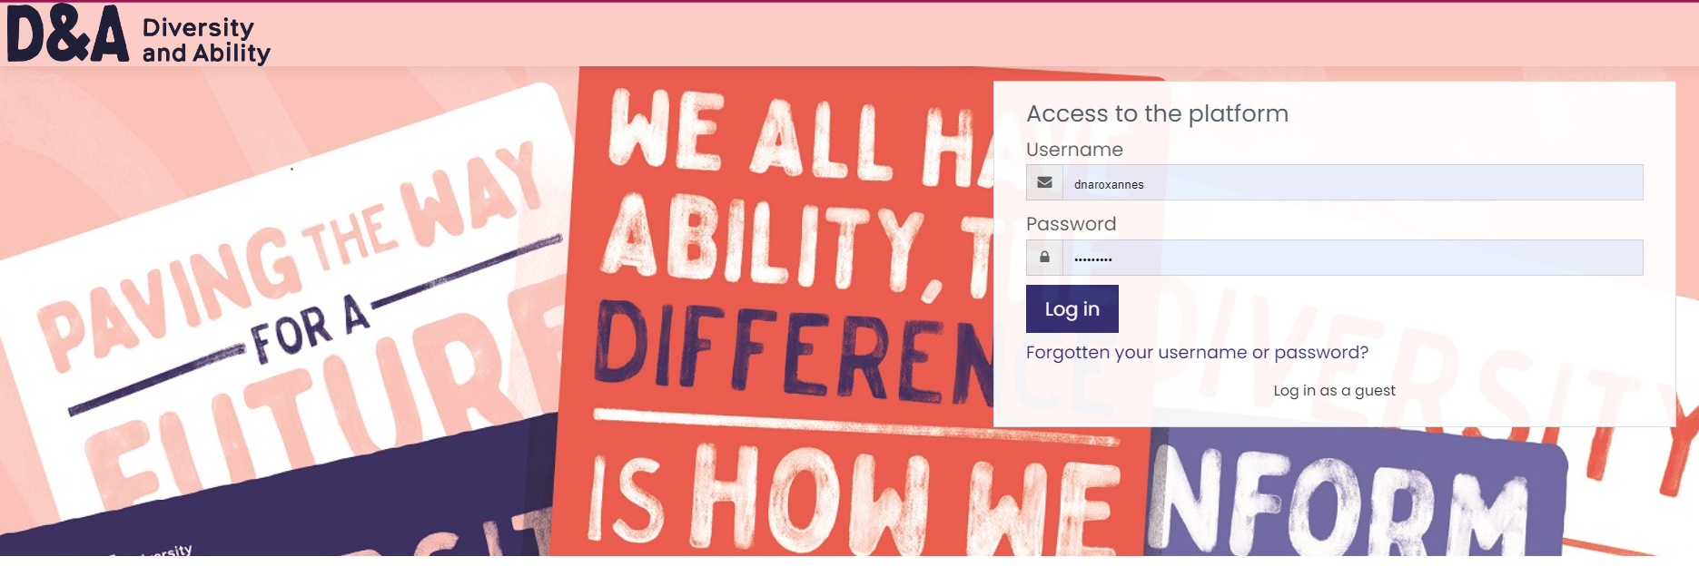
Login page
You will be provided with a log in via COL

Slide 4
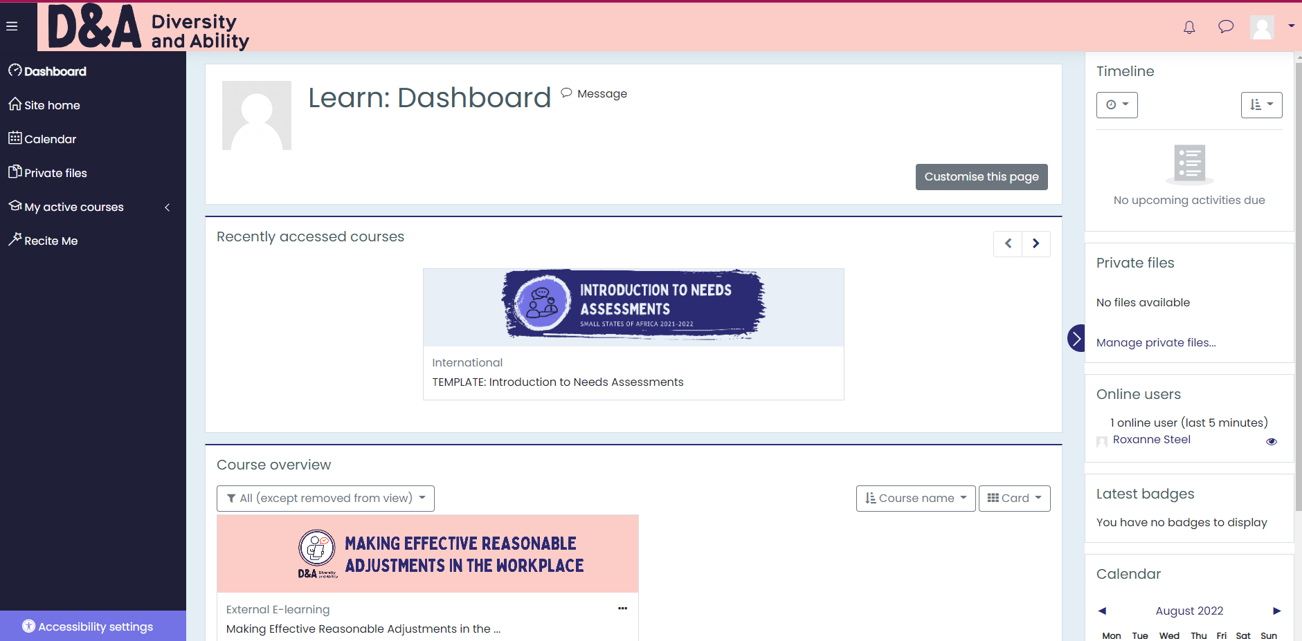
Dashboard
When you log in your Dashboard will appear including your recently accessed course, course overview and your timeline

Slide 5
Navigating
If you can't find what you need on your Dashboard you can navigate using this handy navigation bar found on the left hand side of your screen

Slide 6
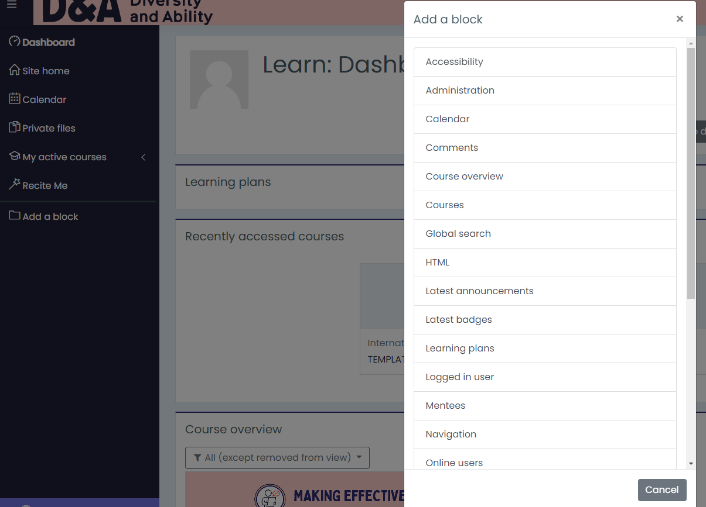
Customising Navigation Options
You can customise your navigation block by selecting add block to bring up this pop out menu

Slide 7
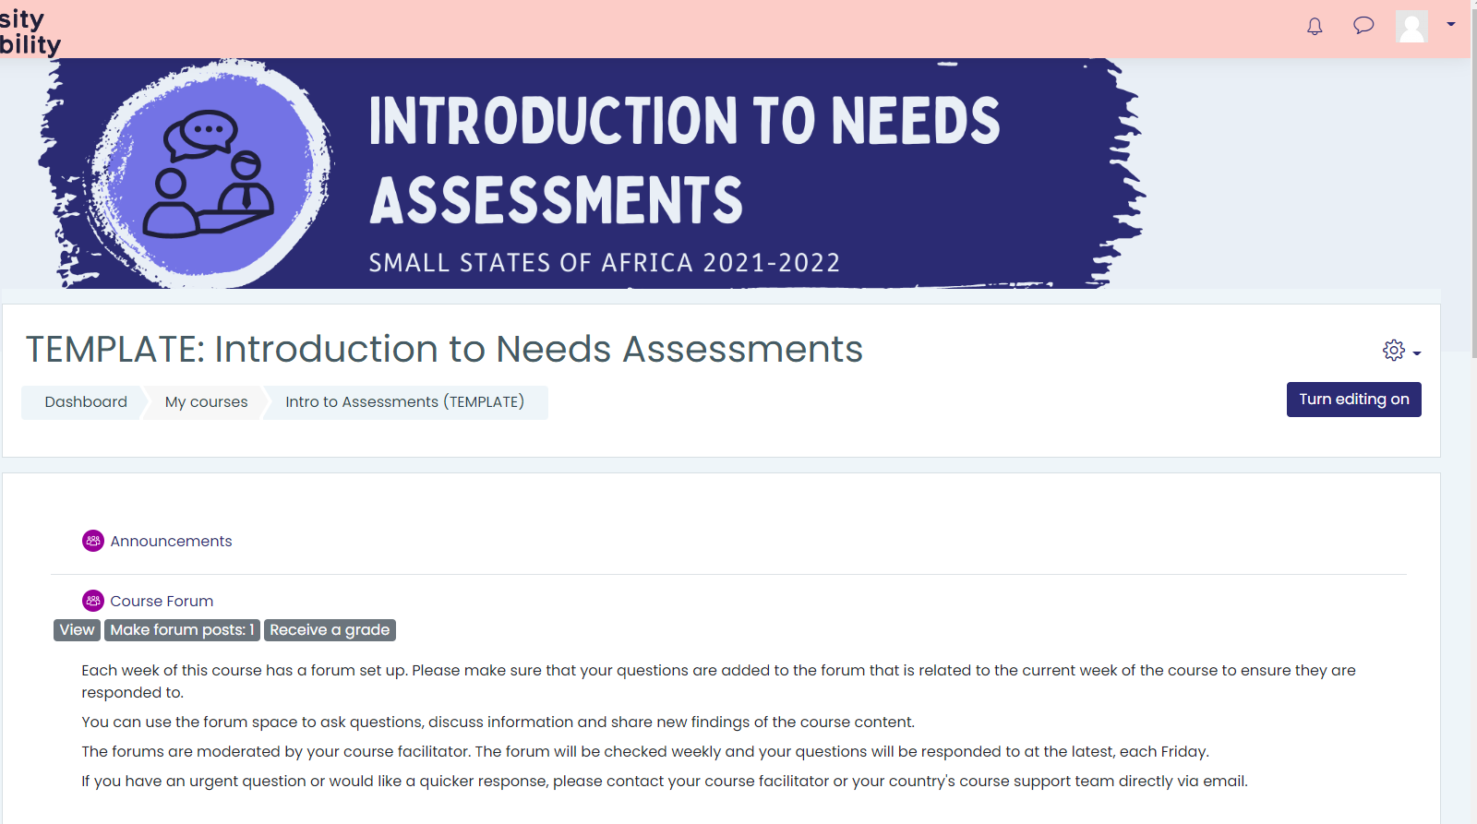
Editing your Moodle
To start editing your moodle (editing, adding text or upload documents)
You must first turn on editing here!

Slide 8
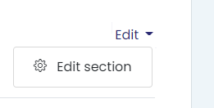
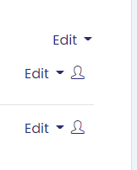
Editing your Moodle
Once you’ve done this you will now see editing options!

Slide 9
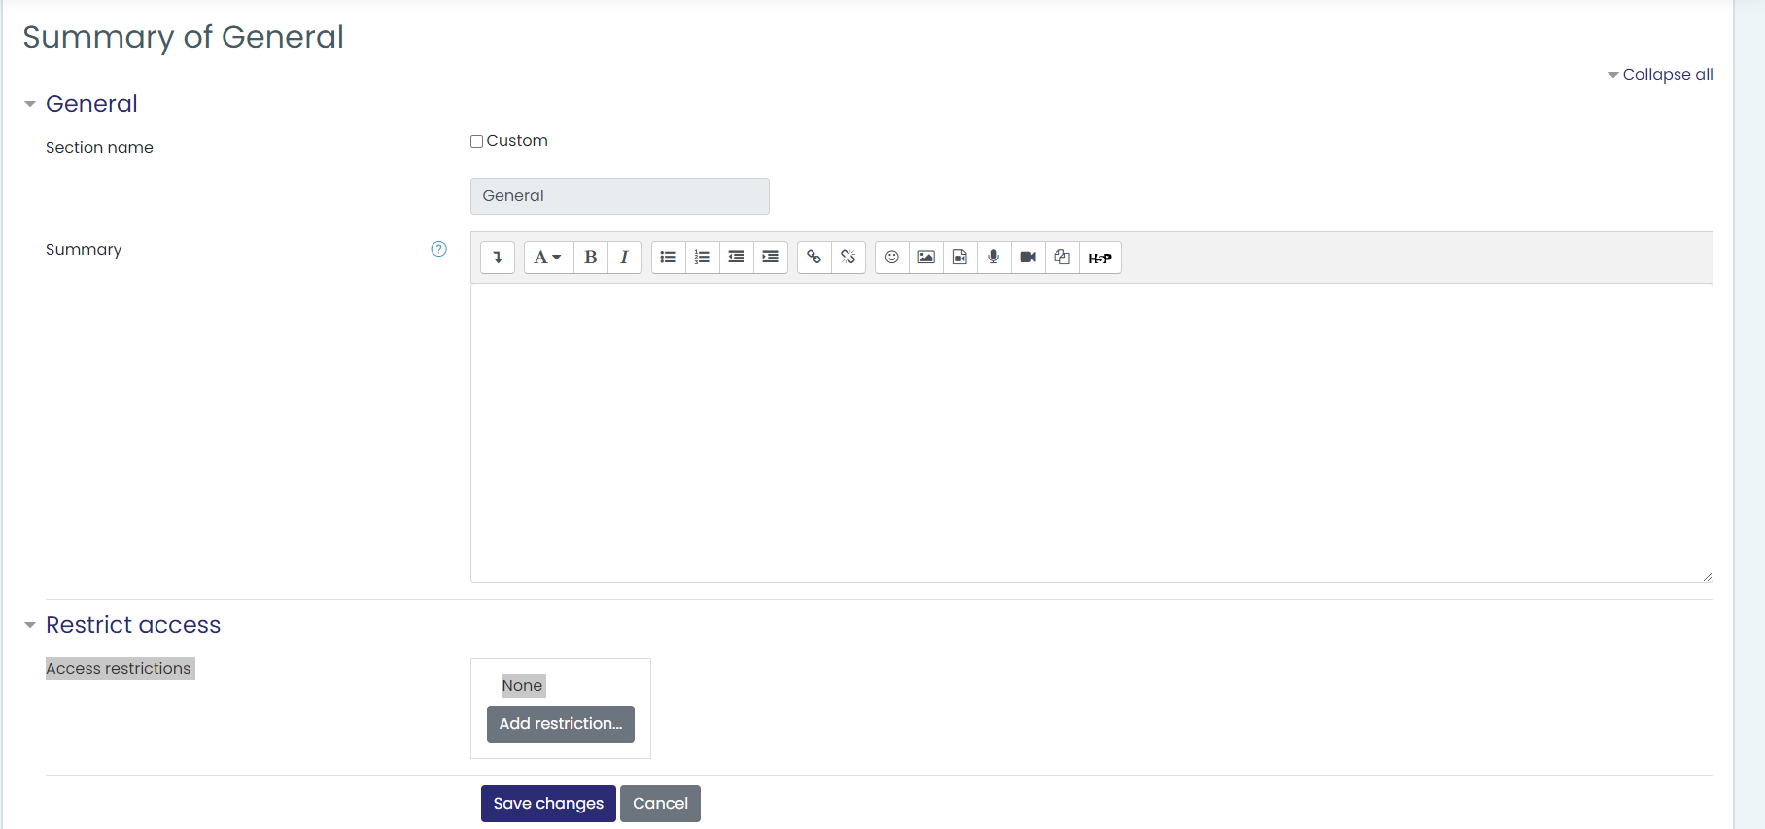
Adding Copy
When editing copy you can also format, add links and images
It is also possible to restrict who has access to this section
Don’t forget to save changes!

Slide 10
Uploading Files
You can also upload folders or files by selecting the pencil icon

Slide 11
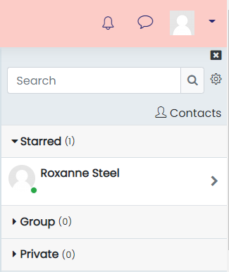
Accessing Messages and Notifications
By selecting either icon will generate a drop down or pop out to enable you to access these

Slide 12
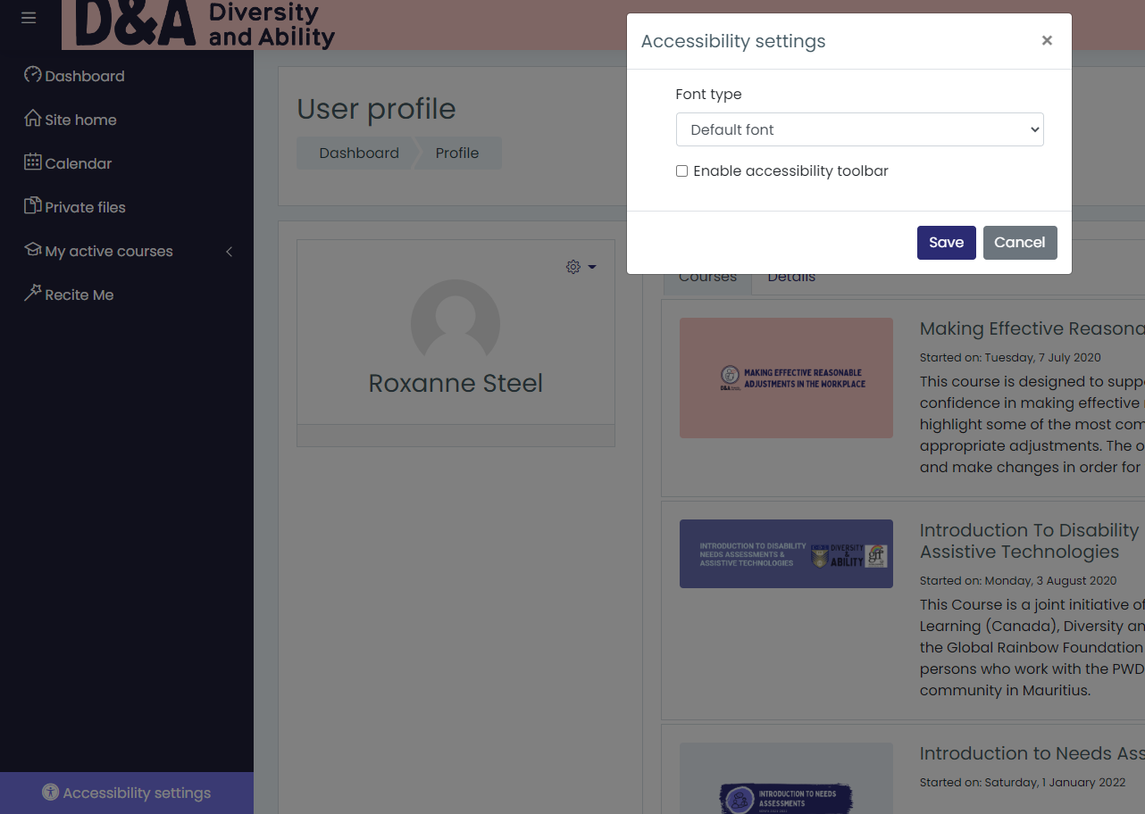
Accessibility Settings
By Selecting Accessibility settings via the navigation bar you are able to enable an accessibility toolbar or simple change the font

