Slide 1
Weekly Reflective Portfolio - Tonga Course
Course 1 - Introduction to Assistive Technology
Your Week 6 Portfolio
Name:
Please add your name here

Slide 2
Introduction - This document is your weekly reflective portfolio.
Each week you will have a portfolio to download.
You should work through the weekly activities set out in the portfolio and also use it to reflect on the weekly course content.
In your reflections you should think critically about how the weekly content impacts on your day to day life and work.
Your assignment tasks are also explained in this portfolio. Each assignment task will be clearly labelled and will be marked by a course facilitator. You should submit your assignment within this portfolio. You will receive feedback on your assignments.
You will need to upload your reflective portfolio at the end of every week (by Sunday). You can submit your portfolio as a link or as a pdf or powerpoint. You will not receive feedback each week. However, the portfolio is an essential part of the course and is a requirement for certification.
If you have any questions, please do get in touch with your facilitators.

Slide 3
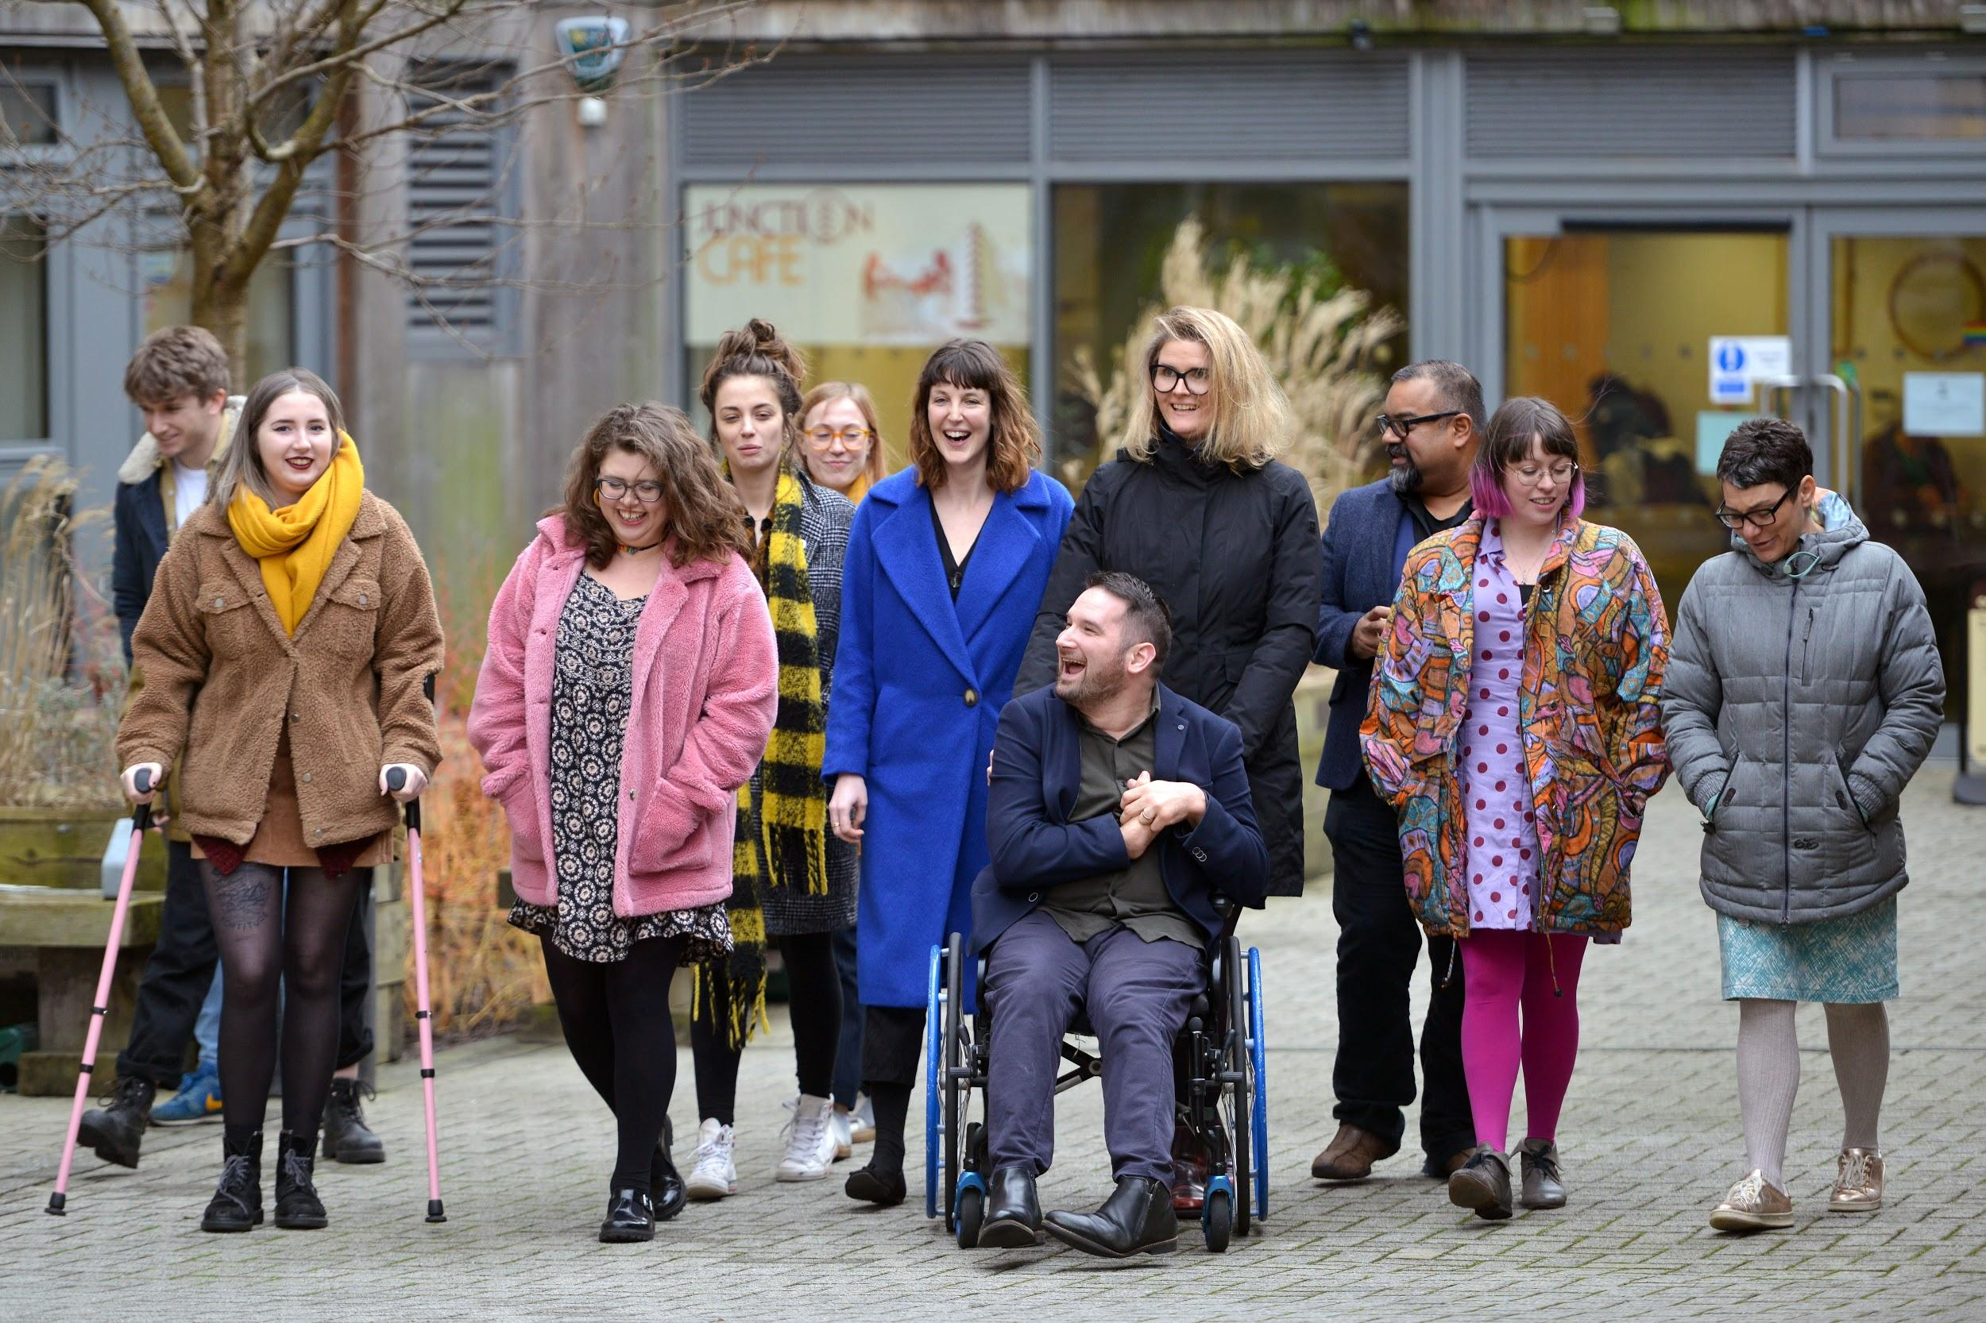
Week 6: Barriers to Organisation and Summary of the Course
Welcome to week 6! This week we are focussing on our final set of tools - assistive technology for organisation.
You will need to complete the following in this portfolio this week:
Google Calendar Activity
Trello Activity
Highlights Activity
Your Reflective Portfolio
There is an assistive technology quiz assignment due this week. This is available via the moodle.
You should upload your portfolio to the moodle platform (as a link, PDF or powerpoint document)

Slide 4
Week 6 - Activities
As you work through the content we would recommend that you collaborate with others on these activities.
These activities are not assessed and are a way for you to expand your knowledge.
You can provide evidence of these activities on the following slides.
This week you should complete all 3 activities:
Google Calendar Activity
Trello Activity
Highlights Activity
The activities are designed to get you thinking about the content and to encourage questions. Each activity is described in the following slides.
Please do post your questions on the forum - the facilitators and your peers will respond to these questions throughout the course.

Slide 5
Activity 1:
Google Calendar
Log into or set up a google calendar
Add a 1-hour event called “Lunch” - colour code this event. You could even try inviting a course peer to your event.
Add an all day event called “Portfolio Deadline” on Sunday. Colour code this differently.
Use the notes section of the event to add some details about either of your events.
Provide a screenshot below.

Slide 6
Activity 2:
Trello
Trello allows you to create innovative boards that contain pictures, reminders, information and checklists.
We would like to you to log in or sign up to Trello and create a board with any theme you would like.
The board should contain a minimum of three columns and should have at least 3 cards. One card must contain an image.
Upload your screenshot to this slide.

Slide 7
Activity 3:
Highlights
Over the last 6 weeks you will have been introduced to a range of different assistive technology software. Please take a moment to reflect on your experience and share your highlights of the course.
My highlights were...

Slide 8
Reflective Account Week 6
Please use this space to reflect on what you have learnt this week.
Some prompts:
How will this new content impact your work?
What did you learn?
Is there anything you’d like to know more about?
Please write your reflection here. You should write between 100-150 words.
You can resize this textbox if necessary.
We are happy for you to upload an audio or video of your reflection if you would prefer.
You can also upload images.
As this is your final reflection on this part of the course, you could include how what you have learned so far will impact your future work.

Slide 9
Your questions, thoughts, comments...
Thank you for completing this week's key activities, content and reflection. You can use this space to share any comments, thoughts or questions that you may have that you’d like the facilitators to be aware of.
Add your questions here...

