Slide 1
Weekly Reflective Portfolio - International Course
Course 1 - Introduction to Assistive Technology
Your Week 5 Portfolio
Name:
Please add your name here

Slide 2
Introduction - This document is your weekly reflective portfolio.
Each week you will have a portfolio to download.
You should work through the weekly activities set out in the portfolio and also use it to reflect on the weekly course content.
In your reflections you should think critically about how the weekly content impacts on your day to day life and work.
Your assignment tasks are also explained in this portfolio. Each assignment task will be clearly labelled and will be marked by a course facilitator. You should submit your assignment within this portfolio. You will receive feedback on your assignments.
You will need to upload your reflective portfolio at the end of every week (by Sunday). You can submit your portfolio as a link or as a pdf or powerpoint. You will not receive feedback each week. However, the portfolio is an essential part of the course and is a requirement for certification.
If you have any questions, please do get in touch with your facilitators.

Slide 3
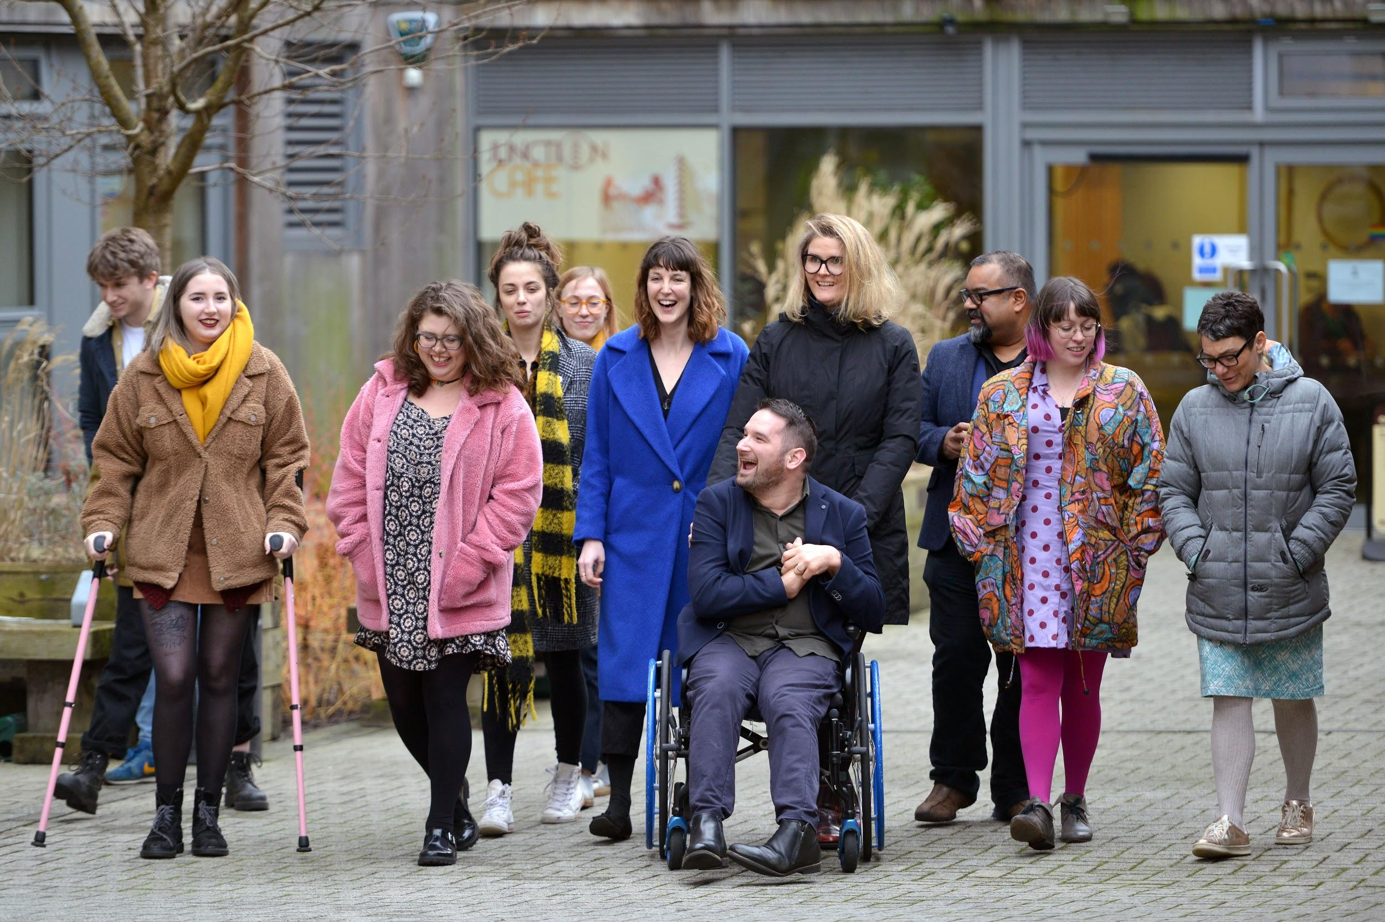
Week 5: Barriers to Communication and Removing Digital Access Barriers
Welcome to week 5! This week we are focussing on tools that support communication, mental health and those that remove digital access barriers.
You will need to complete the following in this portfolio this week:
Tools from the webinars
Mindshift
Windows Accessibility Features
Your Reflective Account on this week's content
There is no assignment due this week.
You should upload your portfolio to the moodle platform (as a link, PDF or powerpoint document)

Slide 4
Week 5 - Activities
As you work through the content we would recommend that you collaborate with others on these activities.
These activities are not assessed and are a way for you to expand your knowledge.
You can provide evidence of these activities on the following slides.
This week you should complete all 3 activities:
Tools from the webinars
Mindshift
Windows Accessibility Features
The activities are designed to get you thinking about the content and to encourage questions. Each activity is described in the following slides.
Please do post your questions on the forum - the facilitators and your peers will respond to these questions throughout the course.

Slide 5
Activity 1:
Tools from the webinars
This week, 2 of the course content videos were webinars that D&A have previously delivered to Needs Assessors in the UK.
Pick 1 tool from the hearing webinar and 1 tool from the vision webinar and complete the following “Technology Profiles”.
Software Name:
Software Name:
….
….
What does it do?
What does it do?
….
….
Who could it support?
Who could it support?
….
….
Notable feature?
Notable feature?
….
….

Slide 6
Activity 2:
Mindshift
Download Mindshift
Try one of the ‘Chill Zone’ Activities.
How does it make you feel? In what scenarios do you think this could be a useful tool?
(Your answer here………)
What features of the app do you like? What features do you think could be improved?
(Your answer here………)

Slide 7
Activity 3:
Windows Accessibility Features
Tim’s video on windows accessibility features covered lots of different content.
We would like you to choose one of the different features Tim highlighted and try it for yourself.
You can add screenshots and text explaining how you got on in the box below.
Which tool did you try? How did you get on?

Slide 8
Reflective Account Week 5
Please use this space to reflect on what you have learnt this week.
Some prompts:
How will this new content impact your work?
What did you learn?
Is there anything you’d like to know more about?
Please write your reflection here. You should write between 100-150 words.
You can resize this textbox if necessary.
We are happy for you to upload an audio or video of your reflection if you would prefer.
You can also upload images.

Slide 9
Your questions, thoughts, comments...
Thank you for completing this week's key activities, content and reflection. You can use this space to share any comments, thoughts or questions that you may have that you’d like the facilitators to be aware of.
Add your questions here...

