Slide 1
Weekly Reflective Portfolio – International Course
Train the Trainer - Week Three including Break Weeks
Your Week 3 Portfolio
Name:
Please add your name here

Slide 2
Introduction - This document is your weekly reflective portfolio.
Each week you will have a portfolio to download.
You should work through the weekly activities set out in the portfolio and also use it to reflect on the weekly course content.
In your reflections you should think critically about how the weekly content impacts on your day to day life and work.
Your assignment tasks are also explained in this portfolio. Each assignment task will be clearly labelled and will be marked by a course facilitator. You should submit your assignment within this portfolio. You will receive feedback on your assignments.
You will need to upload your reflective portfolio at the end of every week (by Sunday). You can submit your portfolio as a link or as a pdf or powerpoint. You will not receive feedback each week. However, the portfolio is an essential part of the course and is a requirement for certification.
If you have any questions, please do get in touch with your facilitators.

Slide 3
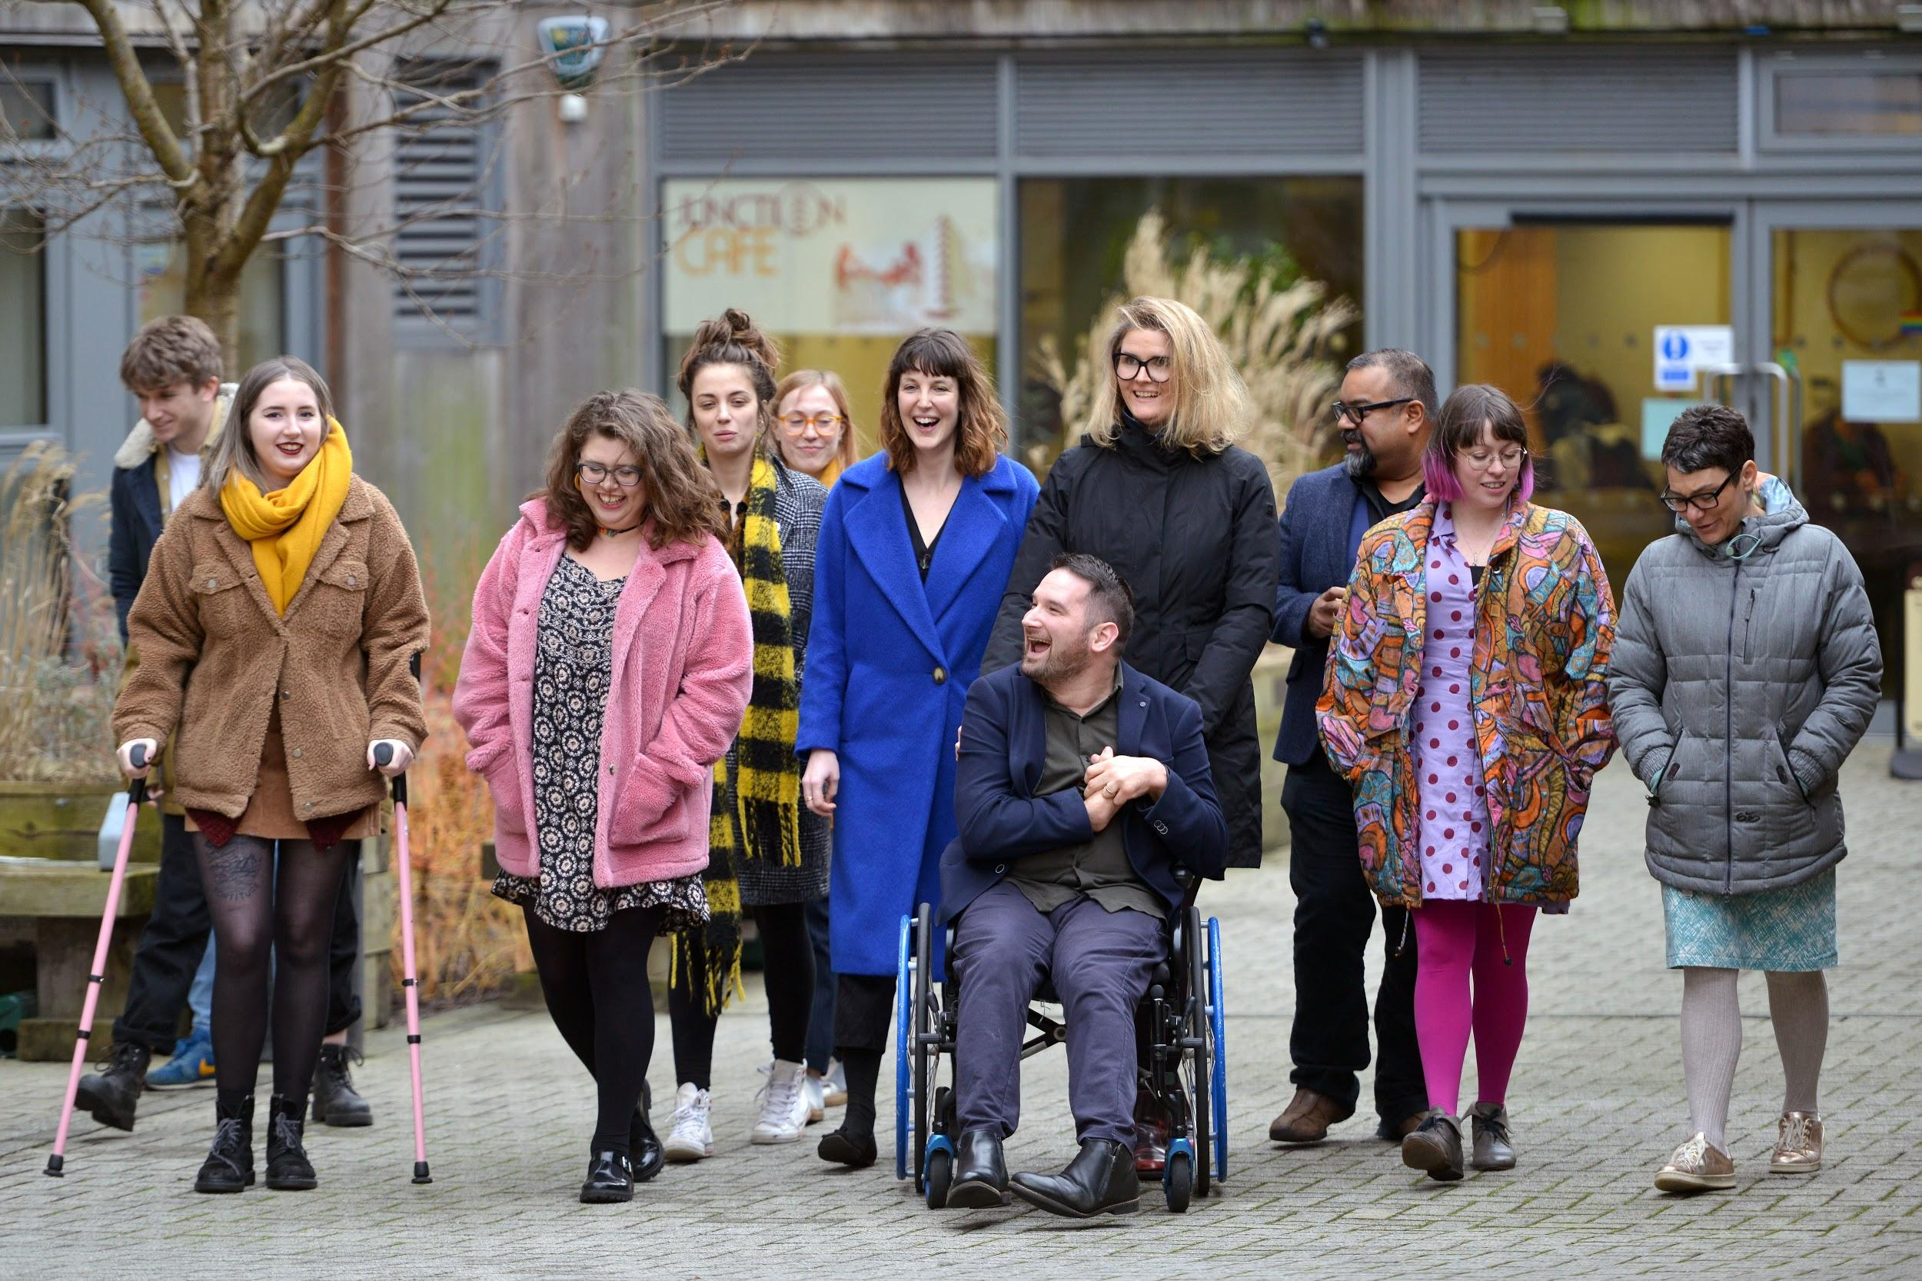
Week 3 Overview of the course administrative duties and logistics
Welcome to week 3 This week we are focussing on the required administrative duties and logistics linked to running a course
This portfolio will also detail any break week activities (Week 4,5)
You will need to complete the following in this portfolio this week:
All week 3 activities
Marked Assignment Details
Your Reflective Account on this week's content
You should then upload your portfolio to the moodle platform (as a link, PDF or powerpoint document)

Slide 4
Week 3 Activities
As you work through the content we would recommend that you collaborate with others on these activities.
These some activities are not assessed and are a way for you to expand your knowledge.
You can provide evidence of these activities on the following slides.
This portfolio will also includes break week expectations
These weeks activities are:
Creating an action plan
Mark a Needs Assessment and Provide Feedback
Exploring your Network Opportunities
The activities are designed to get you thinking about the content and to encourage questions. Each activity is described in the following slides.
Please do post your questions on the forum - the facilitators and your peers will respond to these questions throughout the course.

Slide 5
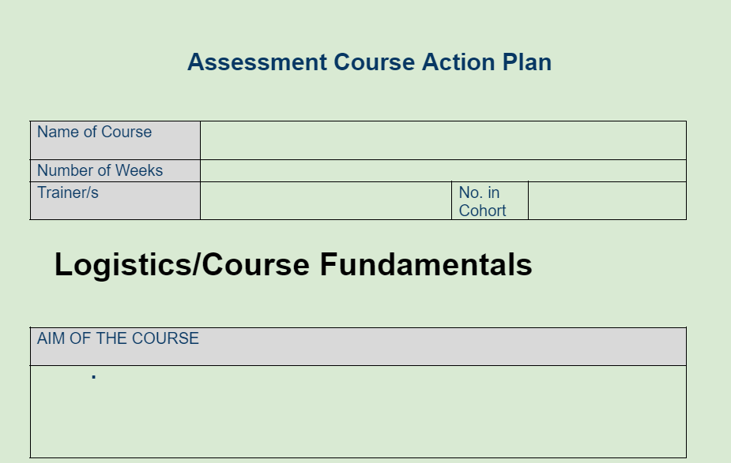
Week Three : Assignment ( Marked)
Creating an Action Plan
Using the provided Action Plan Template document, to plan your first course “Introduction to Assistive Technology”
Notes:
https://docs.google.com/document/d/1TkZD0VPMrYlBDVEo00oaP5RV2llxwe_1CMJaM9-CgGQ/edit

Slide 6
Week Three : Assignment ( Marked)
Mark a Needs Assessment and Provide Feedback
Using the provided documentation:
Needs Assessment Marking Guidance
Mock Marking Assessment: Feedback Template
To Mark this Mock Needs Assessment and provide constructive and supportive feedback
Notes:
https://docs.google.com/document/d/1TkZD0VPMrYlBDVEo00oaP5RV2llxwe_1CMJaM9-CgGQ/edit

Slide 7
Week Three : Assignment ( Not Marked)
Group or Networks I hope to train
We would expect trainers to already have avenues or communities to provide training to following the completion of this course
What groups or networks do you belong to that you will be inviting to your first course
Notes:
https://docs.google.com/document/d/1TkZD0VPMrYlBDVEo00oaP5RV2llxwe_1CMJaM9-CgGQ/edit

Slide 8
Break Week- Activities
As you work through the content we would recommend that you collaborate with others on these activities.
These some activities are not assessed and are a way for you to expand your knowledge.
You can provide evidence of these activities on the following slides.
This portfolio will also includes break week expectations
These weeks activities are:
Creating a session plan
Prepare Mock Delivery
Record Mock Delivery
Provide pairing feedback and self reflecting
Letter to my future self
The activities are designed to get you thinking about the content and to encourage questions. Each activity is described in the following slides.
Please do post your questions on the forum - the facilitators and your peers will respond to these questions throughout the course.

Slide 9
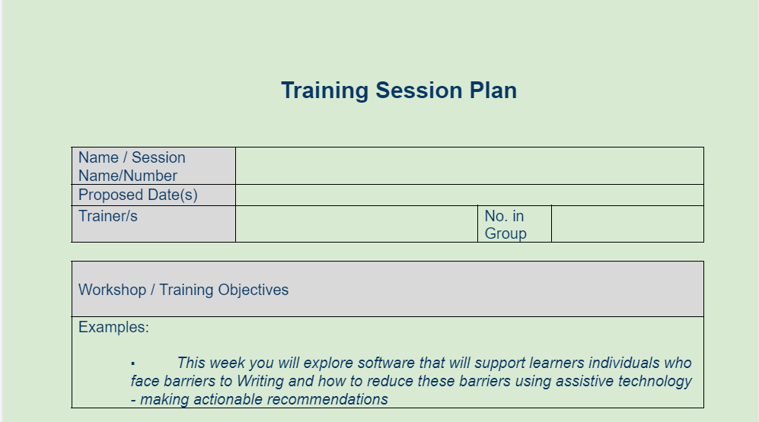
Week Three : Reflection Assignment (Not Marked)
Creating a Session Plan
Using the provided Session Plan Template document, to help plan your first mock session to introduce the first course
This document will help you plan out
Session Objectives
Learning Strategies
Materials needed
Timings
Notes:
#

Slide 10
Break Week: Assignment
Prepare and Record Mock Delivery
In this assignment trainees have been asked to pair up and record a mock delivery of an introductory session to the first course Assistive Technology
Consider skills discussed in previous session/refer back to session slides
Structuring a session
Setting up a facilitation space
Facilitation skills
Teaching Skills
Inclusive and Accessible practices

Slide 11
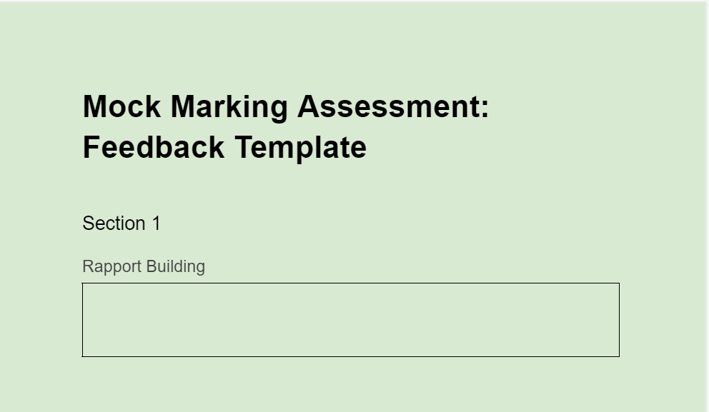
Break Week: Assignment (Marked)
Provide pairing feedback and self reflecting
Part of this assignment trainees have been asked to pair up and act as a participant in a mock delivery of an introductory session to the first course Assistive Technology as well as reflecting on your own performance
Use the provided form to do so
Notes:
https://docs.google.com/document/d/1b49cJnpBGBcwJwmet9gysAdk0tlHvmEnjfRsiM_Ffb0/edit

Slide 12
Break Week: Reflection Assignment (Not Marked)
Letter to my future self
Write a letter of between 250-500 words addressed to yourself from the perspective of 12 months, in the future - reflecting on your aspirations and goals for undertaking this course discussed in Week one as though you have achieved these as well as reflecting on your concerns as if you’ve overcome them and how you did this, and how this has positively impacted your community
Using the space on the next slides, or additional sheet provided to do so

Slide 13
Break Week: Reflection Assignment (Not Marked)
Letter to my future self

Slide 14
Reflective Account
Please use this space to reflect on what you have learnt this week.
Some prompts:
How will this new content impact your work?
What did you learn?
Is there anything you’d like to know more about?
Please write your reflection here. You should write between 100-150 words.
You can resize this textbox if necessary.
We are happy for you to upload an audio or video of your reflection if you would prefer.
You can also upload images.
(You can delete this text)

Slide 15
Your questions, thoughts, comments...
Thank you for completing this week's key activities, content and reflection. You can use this space to share any comments, thoughts or questions that you may have that you’d like the facilitators to be aware of.
Add your questions here...

