Slide 1
Weekly Reflective Portfolio – International Course
Train the Trainer - Week One
Your Week 1 Portfolio
Name:
Please add your name here

Slide 2
Introduction - This document is your weekly reflective portfolio.
Each week you will have a portfolio to download.
You should work through the weekly activities set out in the portfolio and also use it to reflect on the weekly course content.
In your reflections you should think critically about how the weekly content impacts on your day to day life and work.
Your assignment tasks are also explained in this portfolio. Each assignment task will be clearly labelled and will be marked by a course facilitator. You should submit your assignment within this portfolio. You will receive feedback on your assignments.
You will need to upload your reflective portfolio at the end of every week (by Sunday). You can submit your portfolio as a link or as a pdf or powerpoint. You will not receive feedback each week. However, the portfolio is an essential part of the course and is a requirement for certification.
If you have any questions, please do get in touch with your facilitators.

Slide 3
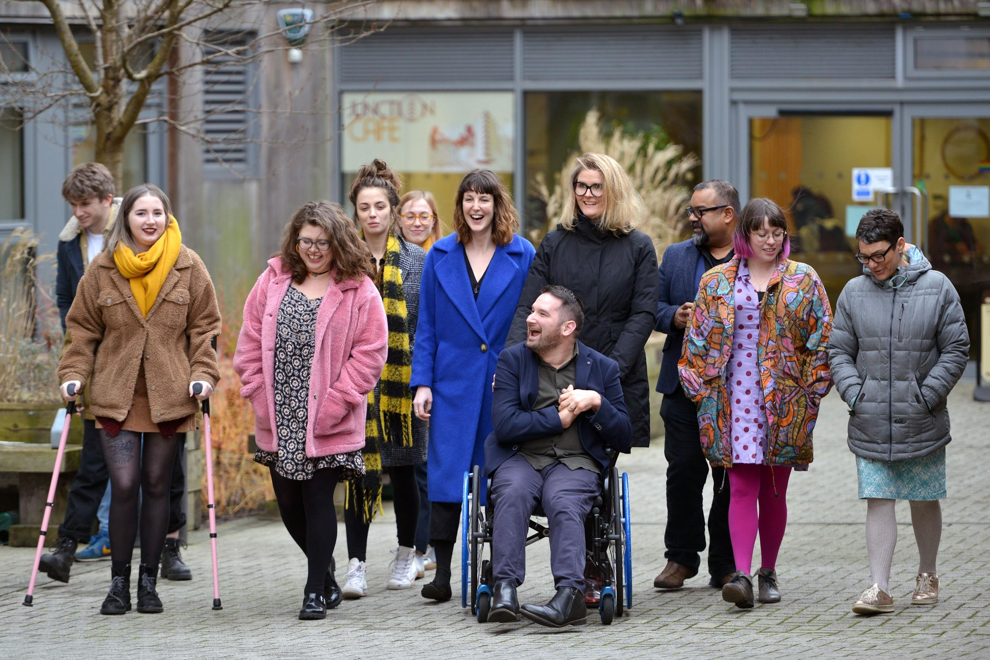
Week 1: Overview of the course and why this work matters
Welcome to week 1! This week we are focussing on understanding the aspirations, impacts, meaning and expectations behind this work. We will also revisit the models of disability, explore the impact of barriers to those facing disablement and asked you to reflect country-wide journey and related disability laws or policies in your regions.
You will need to complete the following in this portfolio this week:
All week 1 activities
Your Reflective Account on this week's content
You should then upload your portfolio to the moodle platform (as a link, PDF or powerpoint document)

Slide 4
Week 1 - Activities
As you work through the content we would recommend that you collaborate with others on these activities.
These activities are not assessed and are a way for you to expand your knowledge.
You can provide evidence of these activities on the following slides.
This weeks activities are:
Disability laws or policies within your regions -
Models of disability - how are these relevant?
Barriers - how can this impact the assessment experience
Impacts for your community
Revisit course materials
The activities are designed to get you thinking about the content and to encourage questions. Each activity is described in the following slides.
Please do post your questions on the forum - the facilitators and your peers will respond to these questions throughout the course.

Slide 5
Week One: Reflection Assignment (Not Marked)
Exploring Disability laws or policies within your regions -
Research your country or region and identify goals, laws or policies that support Disabled People
Now choose two that you can reflect on in further detail (one to two paragraphs minimum each if written )
Using the space on the next slides, or additional sheet provided add images, words, audio, video or pictures to tell us why you have chosen each goal.
Don’t be afraid to get creative!
Choose one goal, law or policy that you think your country is already achieving and how the provision of this training supports this
Now think of a second goal that you think they could do better at and how the provision can support this aim

Slide 6
Week One: Reflection Assignment (Not Marked)
Exploring Disability laws or policies within your regions -
Goal One
Goal Two

Slide 7
Week One: Reflection Assignment (Not Marked)
Models of disability - how are these relevant?
In our live session we discussed the models of disability-
Now consider how and why are these relevant to the Needs Assessment process and How would you explain this to a learner you are teaching?
Using the space on the next slides explain this to a future learner
(in whatever format you would like e.g. text, image, creating a slide, audio file, video etc.)
Don’t be afraid to get creative! Of course!

Slide 8
Week One: Reflection Assignment (Not Marked)
Models of disability - how are these relevant?

Slide 9
Week One: Reflection Assignment (Not Marked)
Barriers - how can this impact the assessment experience
In our live session we discussed disabling barriers
Including
Physical
Attitudinal
Informational
Communication
How could these impact the Needs Assessment process?
And what can we do/what have we already done to overcome these barriers?
Using the space on the next slides to share your thoughts
(in whatever format you would like e.g. text, image, creating a slide, audio file, video etc.)

Slide 10
Week One: Reflection Assignment (Not Marked)
Barriers - how can this impact the assessment experience

Slide 11
Week One: Reflection Assignment (Not Marked)
Impacts for your community
This course is designed to enable you to teach ours to provide Needs Assessments within your community
Can you think of 3 impacts of having access to these assessments could have on you community
Impact 1:
Impact 2:
Impact 3:

Slide 12
Week One: Revisit Course Materials from the two courses and detail any questions or reflections below
Assistive Technology
Needs Assessment

Slide 13
Reflective Account Week 1
Please use this space to reflect on what you have learnt this week.
Some prompts:
How will this new content impact your work?
What did you learn?
Is there anything you’d like to know more about?
Please write your reflection here. You should write between 100-150 words.
You can resize this textbox if necessary.
We are happy for you to upload an audio or video of your reflection if you would prefer.
You can also upload images.
(You can delete this text)

Slide 14
Your questions, thoughts, comments...
Thank you for completing this week's key activities, content and reflection. You can use this space to share any comments, thoughts or questions that you may have that you’d like the facilitators to be aware of.
Add your questions here...

