Slide 1
Weekly Reflective Portfolio – International Course
Course 2 - Introduction to Needs Assessments
Your Week 3 Portfolio
Name:
Please add your name here

Slide 2
Introduction - This document is your weekly reflective portfolio.
Each week you will have a portfolio to download.
You should work through the weekly activities set out in the portfolio and also use it to reflect on the weekly course content.
In your reflections you should think critically about how the weekly content impacts on your day to day life and work.
Your assignment tasks are also explained in this portfolio. Each assignment task will be clearly labelled and will be marked by a course facilitator. You should submit your assignment within this portfolio. You will receive feedback on your assignments.
You will need to upload your reflective portfolio at the end of every week (by Sunday). You can submit your portfolio as a link or as a pdf or powerpoint. You will not receive feedback each week. However, the portfolio is an essential part of the course and is a requirement for certification.
If you have any questions, please do get in touch with your facilitators.

Slide 3
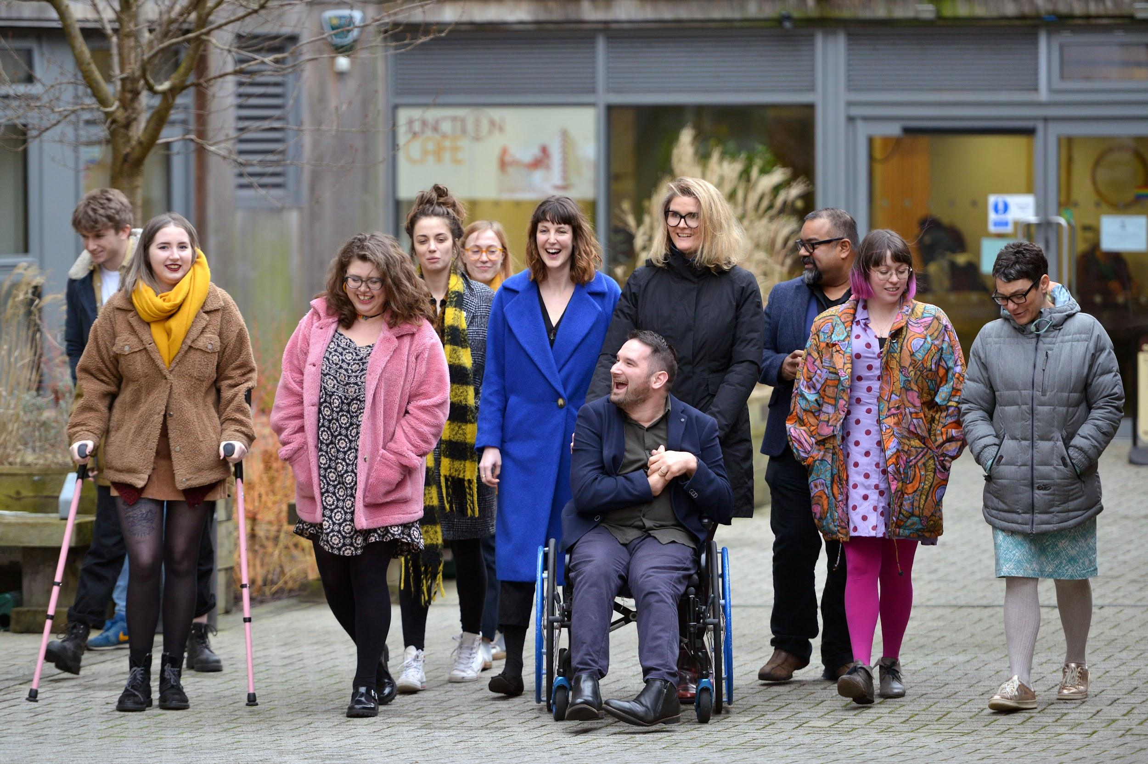
Week 3: Talking about barriers and disability in the Needs Assessment
Welcome to week 3! This week we will start to think about barriers in the needs assessment and discussing these in a sensitive, empathetic and supportive manner.
You will need to complete the following in this portfolio this week:
All week 3 activities
Your Reflective Account on this week's content
You should then upload your portfolio to the moodle platform (as a link, PDF or powerpoint document) by the end of the week.

Slide 4
Week 3 - Activities
As you work through the content we would recommend that you collaborate with others on these activities.
These activities are not assessed and are a way for you to expand your knowledge.
You can provide evidence of these activities on the following slides.
This weeks activities are:
Disabled person or person with a disability?
Barriers and strategies
The activities are designed to get you thinking about the content and to encourage questions. Each activity is described in the following slides.
Please do post your questions on the forum - the facilitators and your peers will respond to these questions throughout the course.

Slide 5
Activity 1:
Disabled person or person with a disability?
Throughout the course you will hear different language and terminology being used. Language is important to get right as when used well it can be enabling and create a space of safety and belonging. When used poorly it can contribute to stigmatisation and distress.
“Disabled person” and “person with a disability” are often used interchangeably, although there is a term that is preferred by the community. Which term do you think is more enabling and supportive, and why?
Which term do you choose?
Why did you choose this term?

Slide 6
Activity 2:
Barriers and strategies
We use the term “barriers” to identify difficulties that an individual is experiencing. When you are needs assessing you will need to help identify barriers for the assessee that you are supporting.
In preparation for this, we would like you to identify 2 different barriers that you may experience in your work or day to day life (e.g. finding reading very tiring or find managing time difficult).
We would then like you to choose a piece of assistive technology that may help you to overcome this barrier and justify your choice.
The 1st barrier I experience is…
The technology that could support me is…
The justification for this is...
The 2nd barrier I experience is…
The technology that could support me is…
The justification for this is...

Slide 7
Reflective Account Week 3
Please use this space to reflect on what you have learnt this week.
Some prompts:
How will this new content impact your work?
What did you learn?
Is there anything you’d like to know more about?
Please write your reflection here. You should write between 100-150 words.
You can resize this textbox if necessary.
We are happy for you to upload an audio or video of your reflection if you would prefer.
You can also upload images.
(You can delete this text)

Slide 8
Your questions, thoughts, comments...
Thank you for completing this week's key activities, content and reflection. You can use this space to share any comments, thoughts or questions that you may have that you’d like the facilitators to be aware of.
Add your questions here...

