Slide 1
Weekly Reflective Portfolio - International Course
Train the Trainer - Week Six
Your Week 6 Portfolio
Name:
Please add your name here

Slide 2
Introduction - This document is your weekly reflective portfolio.
Each week you will have a portfolio to download.
You should work through the weekly activities set out in the portfolio and also use it to reflect on the weekly course content.
In your reflections you should think critically about how the weekly content impacts on your day to day life and work.
Your assignment tasks are also explained in this portfolio. Each assignment task will be clearly labelled and will be marked by a course facilitator. You should submit your assignment within this portfolio. You will receive feedback on your assignments.
You will need to upload your reflective portfolio at the end of every week (by Sunday). You can submit your portfolio as a link or as a pdf or powerpoint. You will not receive feedback each week. However, the portfolio is an essential part of the course and is a requirement for certification.
If you have any questions, please do get in touch with your facilitators.

Slide 3
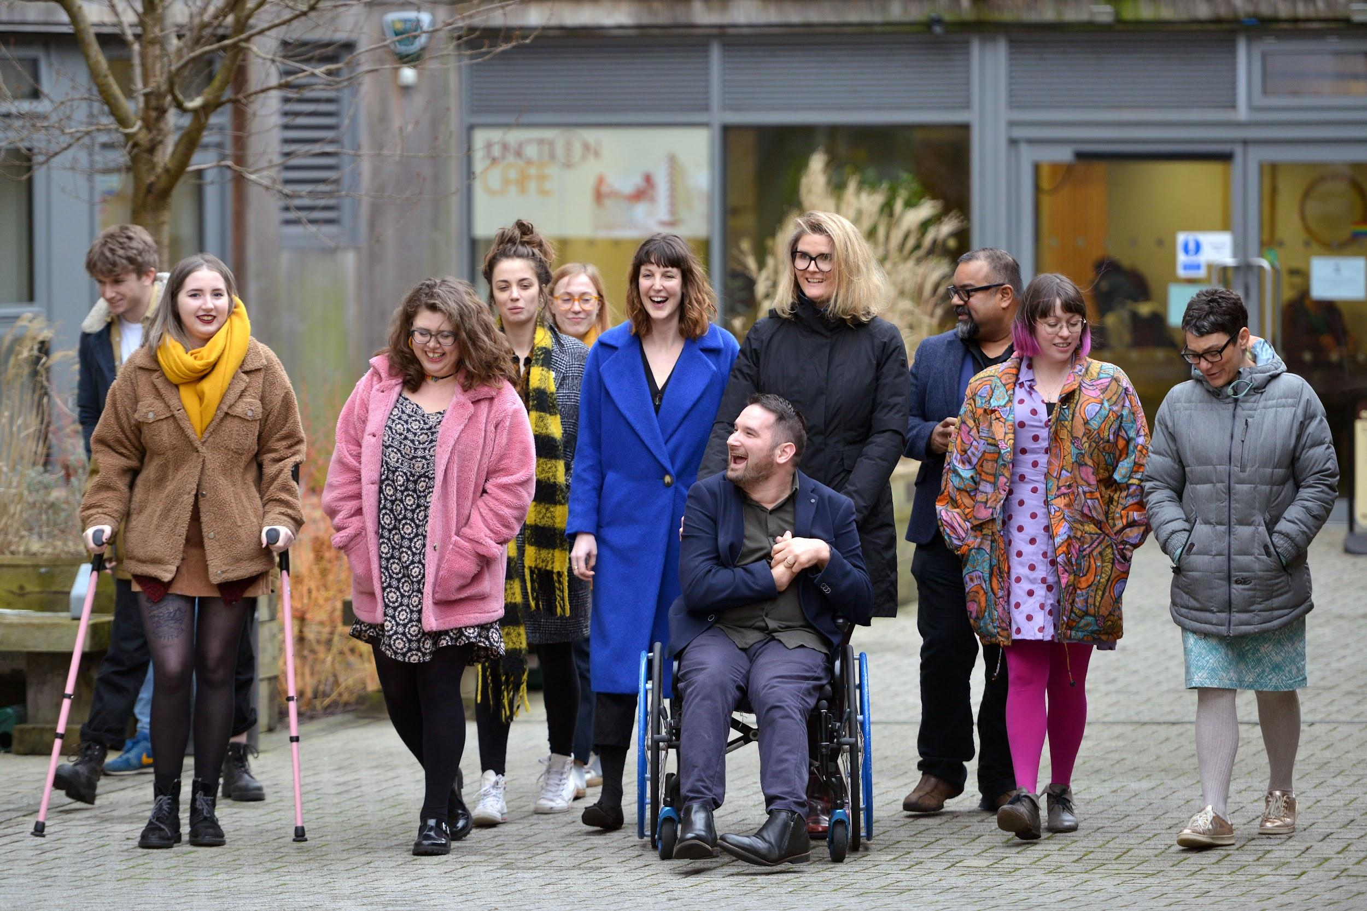
Week 6: Reflective thinking, legacy building and future aspirations
Welcome to week 6! This is the final week of the course. The focus this week is on future aspirations and the legacy that this course has left. We will ask you to reflect on your achievements and discuss ongoing reflective practice.
You will need to complete the following in this portfolio this week:
All week 6 activities
Your Reflective Account on this week's content
You should then upload your portfolio to the moodle platform (as a link, PDF or powerpoint document) by the end of the week.

Slide 4
Week 6 - Activities
As you work through the content we would recommend that you collaborate with others on these activities.
These activities are not assessed and are a way for you to expand your knowledge.
You can provide evidence of these activities on the following slides.
This weeks activities are:
What are your aspirations for future learners following this course?
Where do you think Assistive Technology Training will be in 10 years time?
The activities are designed to get you thinking about the content and to encourage questions. Each activity is described in the following slides.
Please do post your questions on the forum - the facilitators and your peers will respond to these questions throughout the course.

Slide 5
Week Six: Reflection Assignment (Not Marked)
What are your aspirations for your future learners following a course?
The 1st barrier I experience is…
The technology that could support me is…
The justification for this is...
This course has been designed to be intensive to enable you to leave the course with the knowledge required to start training others where appropriate. What are your aspirations for your future learners
My aspirations for my future learners of my course are.

Slide 6
Week Six: Reflection Assignment (Not Marked)
Where do you think Assistive Technology Training will be in 10 years time?
If we were to be able to look 10 years into the future, where do you think Assistive Technology Training will be in your country? What do you think will have changed? Will what you’ve learnt play a part in that?
Where do you hope that Assistive Technology will be in 10 years time? Share your thoughts below.
Looking 10 years into the future....

Slide 7
Reflective Account
Please use this space to reflect on what you have learnt this week.
Some prompts:
How will this new content impact your work?
What did you learn?
Is there anything you’d like to know more about?
Please write your reflection here. You should write between 100-150 words.
You can resize this textbox if necessary.
We are happy for you to upload an audio or video of your reflection if you would prefer.
You can also upload images.
(You can delete this text)

Slide 8
Your questions, thoughts, comments...
Thank you for completing this week's key activities, content and reflection. You can use this space to share any comments, thoughts or questions that you may have that you’d like the facilitators to be aware of.
Add your questions here...

