Slide 1
Weekly Reflective Portfolio – International Course
Course 1 - Introduction to Assistive Technology
Your Week 1 Portfolio
Name:
Please add your name here

Slide 2
Introduction - This document is your weekly reflective portfolio.
Each week you will have a portfolio to download.
You should work through the weekly activities set out in the portfolio and also use it to reflect on the weekly course content.
In your reflections you should think critically about how the weekly content impacts on your day to day life and work.
Your assignment tasks are also explained in this portfolio. Each assignment task will be clearly labelled and will be marked by a course facilitator. You should submit your assignment within this portfolio. You will receive feedback on your assignments.
You will need to upload your reflective portfolio at the end of every week (by Sunday). You can submit your portfolio as a link or as a pdf or powerpoint. You will not receive feedback each week. However, the portfolio is an essential part of the course and is a requirement for certification.
If you have any questions, please do get in touch with your facilitators.

Slide 3
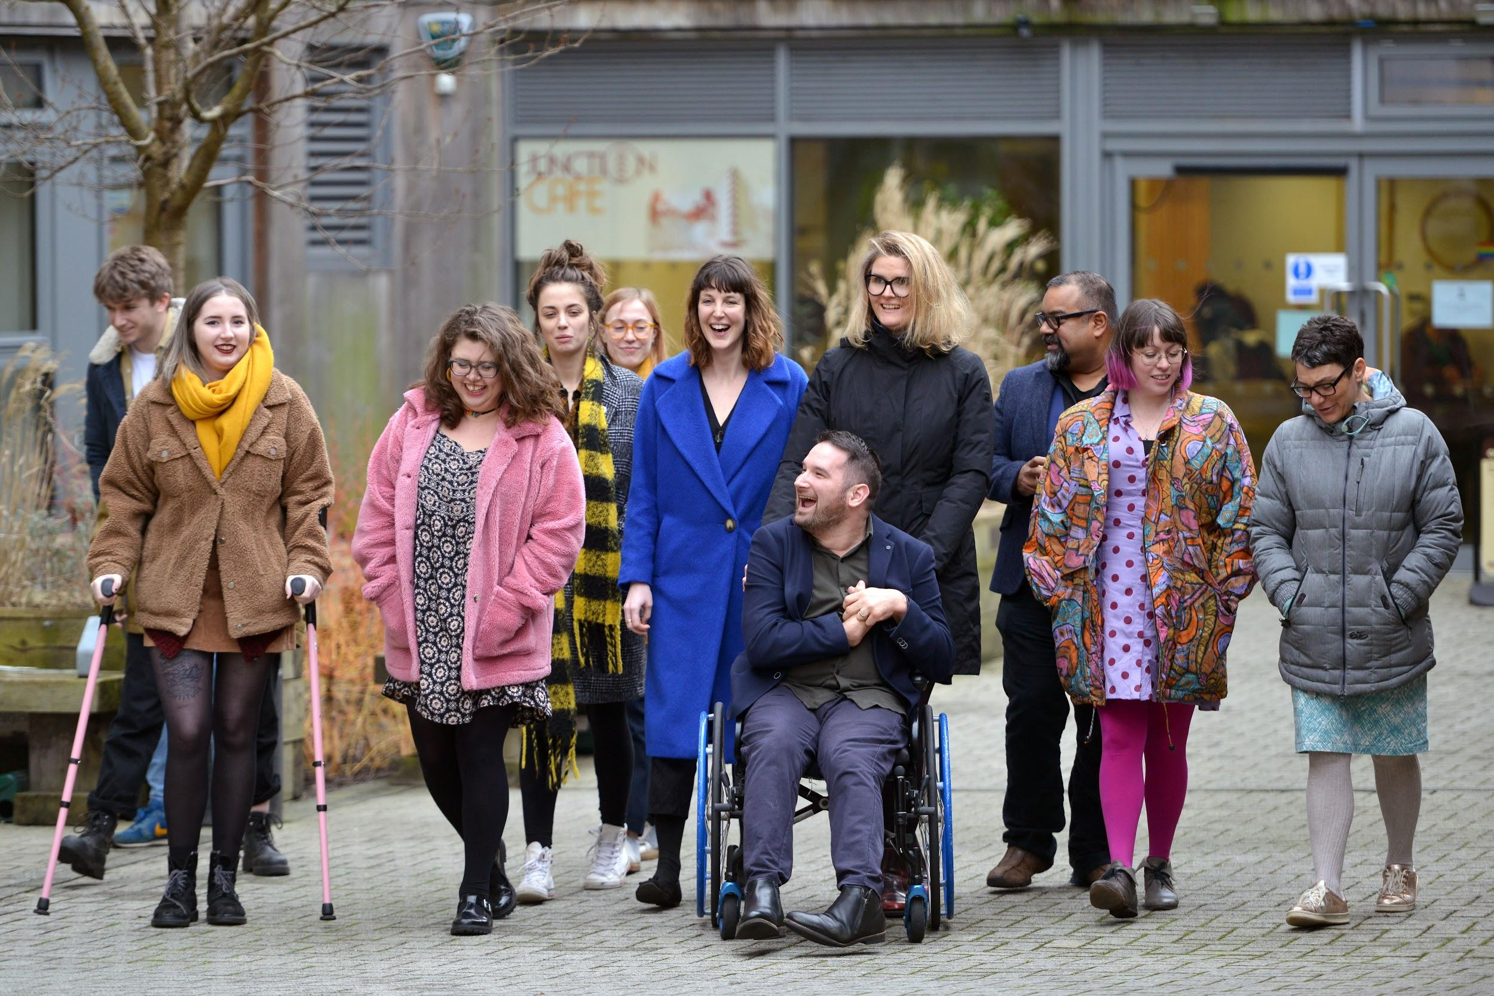
Week 1: Overview of the course and why this work matters
Welcome to week 1! This week we are focussing on understanding the aspirations, impacts & meaning behind this work. We will also explore the models of disability, country-wide journey and the disability accords.
You will need to complete the following in this portfolio this week:
All week 1 activities
Your Reflective Account on this week's content
Your first assignment: Letter to the Ministry of Education
You should then upload your portfolio to the moodle platform (as a link, PDF or powerpoint document)

Slide 4
Week 1 - Activities
As you work through the content we would recommend that you collaborate with others on these activities.
These activities are not assessed and are a way for you to expand your knowledge.
You can provide evidence of these activities on the following slides.
This weeks activities are:
The Sustainable Development Goals - in depth exploration
Models of disability - reframe your thinking
Goal setting - your aspirations for this course
The activities are designed to get you thinking about the content and to encourage questions. Each activity is described in the following slides.
Please do post your questions on the forum - the facilitators and your peers will respond to these questions throughout the course.

Slide 5
Activity 1:
The Sustainable development goals - in depth exploration
Choose one goal that you think your country is already achieving and a 2nd goal that you think they could do better at.
Using the space below, add images, words, audio, video or pictures to tell us why you have chosen each goal.
We are achieving goal....
We could do better at goal...

Slide 6
Activity 2:
Models of Disability - Reframe your thinking
In the video on the social model Atif spoke about how glasses have been normalised.
Why do you think that glasses have been normalised as a piece of assistive technology?
Share your thoughts below (in whatever format you would like e.g. text, image, mindmap, audio file, video etc.)

Slide 7
Activity 3:
Goal setting - Your Aspirations for this Course
This course is designed to be full of information that you can apply to your own day-to-day life or work.
What would you like to get out of taking part in this course? Write your goals below.
Goal 1:
Goal 2:
Goal 3:

Slide 8
Week 1 - Assignment
Use this space to complete assignment 1.
Write a letter of between 250-500 words addressed to the Minister for Education from the perspective of a PWD, highlighting the impact of the signed Disability Accords on daily living, education, and workplace.
Please write your letter here. You should write between 200-250 words.
The full letter task assignment brief is available via moodle.
You can resize this textbox if necessary or continue onto a new slide.
We are happy for you to upload an audio or video of your assignment or to create and upload a mindmap, if you would prefer.
(You can delete this text)

Slide 9
Reflective Account Week 1
Please use this space to reflect on what you have learnt this week.
Some prompts:
How will this new content impact your work?
What did you learn?
Is there anything you’d like to know more about?
Please write your reflection here. You should write between 100-150 words.
You can resize this textbox if necessary.
We are happy for you to upload an audio or video of your reflection if you would prefer.
You can also upload images.
(You can delete this text)

Slide 10
Your questions, thoughts, comments...
Thank you for completing this week's key activities, content and reflection. You can use this space to share any comments, thoughts or questions that you may have that you’d like the facilitators to be aware of.
Add your questions here...

